Slide 1
Correlations
How to use math to figure out correlations

Slide 2
Common Misconception
A correlation DOES NOT MEAN a causation
Just because two things are correlated does not mean one causes the other to happen
https://www.huffingtonpost.com/2014/05/15/spurious-correlations-graphs-make-no-sense-video_n_5325835.html
IB Bio

Slide 3
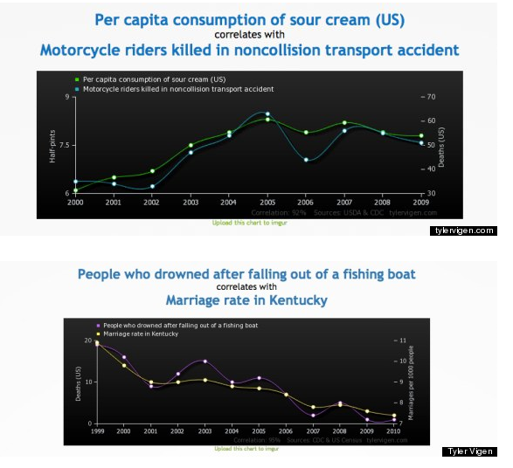
While there are correlations….
Sour cream consumption does not CAUSE motorcycle death (as far as we know
People getting married in kentucky DOES NOT cause people to fall out of boats and drown (as far as we know

Slide 4
Scatterplots can give us a quick visual/ rough idea if two variables are correlated
When scatter dots go from bottom left to upper right= Positive/ Direct relationship
These relationships can be strong or weak (we will discuss this further)

Slide 5
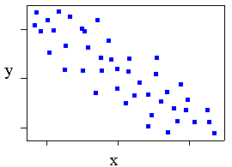
Scatterplots can give us a quick visual/ rough idea if two variables are correlated
When scatter dots go from upper left to bottom right= Negative/ Indirect relationship
These relationships can be strong or weak (we will discuss this further)
Weak negative correlation

Slide 6
NOTE TO SELF!!!!!!!
Don’t associate positive with strong or good… It is simply stating the direction of the trend
Likewise don’t associate negative with a weak or bad relationship… Simply telling us how the graph looks

Slide 8
But Ms. Willson I want to say that there is a causal relationship (i.e. x causes y) How can I EVER do this?!?!?!?!
Well young grasshoper… You do an experiment :0
In a CONTROLLED STUDY you get two groups of individuals who are comparable in every way and give them two different treatments
If results/ outcomes are drastically different, one treatment may have caused an outcome

Slide 9
This is great BUT… what is the BEST way to know how strongly correlated two variables are. I need me some NUMBERS Dude!!!!!

Slide 10
KARL PEARSON and the Pearson Correlation Coefficient (r)

Slide 11
Mind blown
We’ll Break it down

Slide 12
Multiply X with its associated y for every value you collected
Add up all of your y values
Square each x value and add them together
How many samples you took
Square each y value and add them together
Add up all of your x values
TYPO
Square root
Parentheses

Slide 13
Still lost miss willson!!!

Slide 14
Here’s the practice problem
X | Y
5 | 45
15 | 32
18 | 37
20 | 33
25 | 24
25 | 29
30 | 26
34 | 22
38 | 24
50 | 15

Slide 15
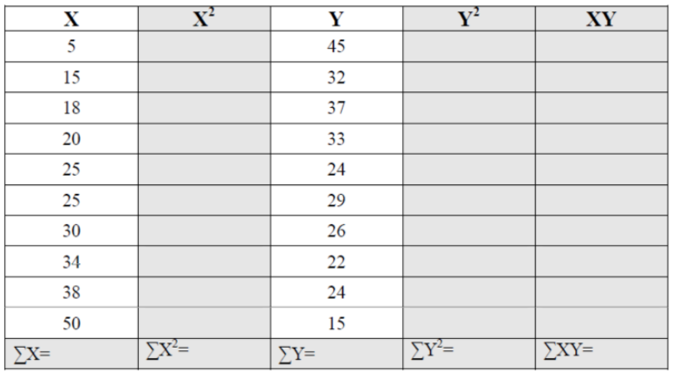
Here’s a suggested way to set up your table of info

Slide 16
Now go through the steps on your handout. If you need help, ask a friend or ask me

