Slide 1
Welcome! 12/7/17
Warm up
HW / WS check
Today:
Wave characteristics
Nuclear fission and Nuclear fusion
Intro to Bohr’s model
Quiz????
Pd. 1 – Tuesday
PopQuiz retake: today after school with your retake form.
HW tonight; Reading questions from the book.

Slide 2
Warm up
Calculate the atomic mass for the following elements using the weighted average method on the back of this piece of paper. Circle your answer.
69.17% ⁶³Cu and 30.83% ⁶⁵Cu.
How are Cu- 63 and Cu-65 similar and different from each other?

Slide 3
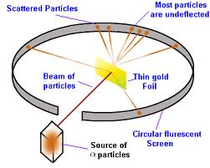
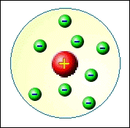
Models of the Atom
Ernest Rutherford proposed an atom with a nucleus and negative particles moving around the nucleus.

Slide 4
The next major step forward on the model of the atom came after some important breakthroughs in our understanding of the electromagnetic spectrum
light behaves like a wave, but also like a stream of extremely tiny, fast-moving particles (wave-particle duality)
light is a form of electromagnetic radiation

Slide 5
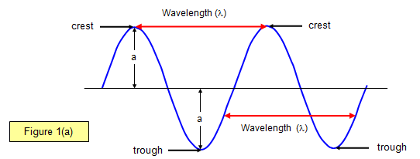
Amplitude: height of wave from origin to crest

Slide 6
Wavelength (λ): distance between successive crests
(lambda)

Slide 7
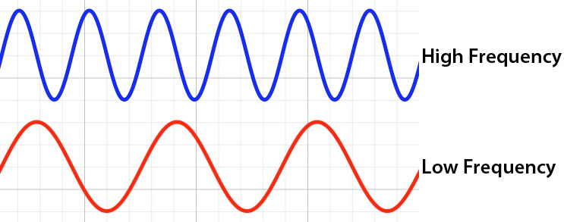
Frequency (ν):
how fast wave oscillates. Number of waves per second.
* High frequency → high energy
Greek letter “nu”

Slide 8
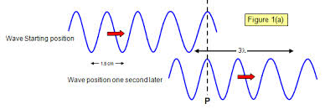
Speed of light (c): 3.00 x 10⁸ meters per second
c=λv
If λ is low, then v must be large since c is constant; the reverse is also true.
Long λ light is low energy
Short λ is high energy

Slide 9
Welcome 12/8/17
Warm up
Sketch a diagram of a wave and label the amplitude and wavelength.
What is the relationship between frequency and wavelength? (Direct or Inverse)
What is the relationship between frequency and energy? (Direct or Inverse)
Today:
Bohr’s Model
HW discussion
HW Due Monday: Reading Questions from fission and fusion

Slide 10
The visible spectrum of light is just part of the EM spectrum- the part detectable by the human eye

Slide 11
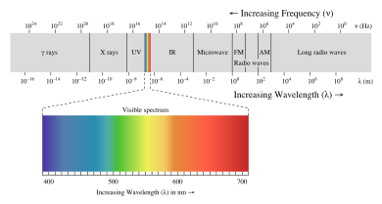
Visible light has a wavelength ranging from around 400-800 nm, with different colors each falling somewhere in that range.

Slide 12
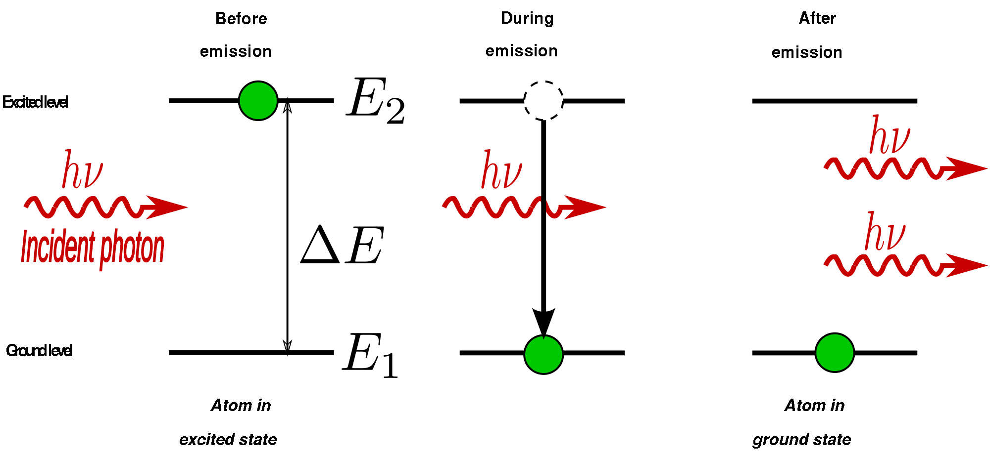
MAX PLANCK
…in 1900, proposed that energy is only available in discrete packets, or quanta (singular is quantum); the size of the quantum is related to the frequency of the radiation by a simple equation.

Slide 13
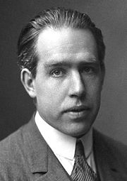
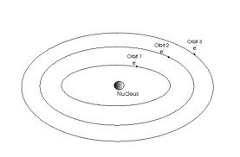
Now Back to Electrons
Danish scientist Neils Bohr (1885-1962) applied Planck’s idea of quantized energy to the model of the atom and helped explain why different elements emit different spectra by going back to the electron.

Slide 14
Welcome 12/8/17
Warm up
Complete the following nuclear reaction
What is the difference between Nuclear fission and fusion?
Quiz on Tuesday:
Atoms structure(atomic num, mass num, av. Atomic mass, num of P,E,N)
Nuclear chemistry
HW: Reading questions

Slide 15
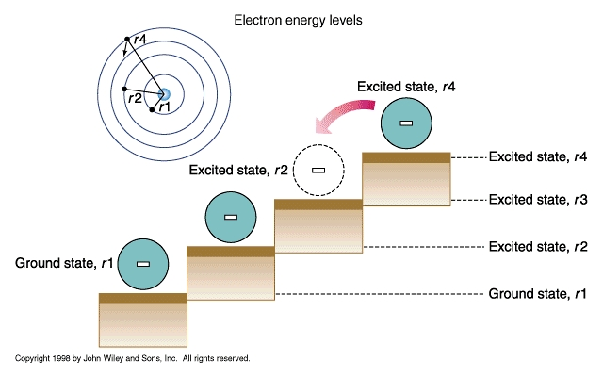
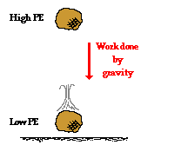
Potential energy of an electron in an atom depends on the electron’s distance from the nucleus.
When an atom is not excited (ground state), its electrons are in orbit close to the nucleus
If an atom gains energy (excited state), and electron is displaced farther away from the nucleus

Slide 16
Now Back to Electrons
Bohr realized the opposite is also true:
A high-potential (energized) electron won’t hang on to that energy for too long. Once it loses that energy, the electron moves closer to the nucleus.
The energy isn’t “lost” of course, instead it is emitted as a photon of light

Slide 17
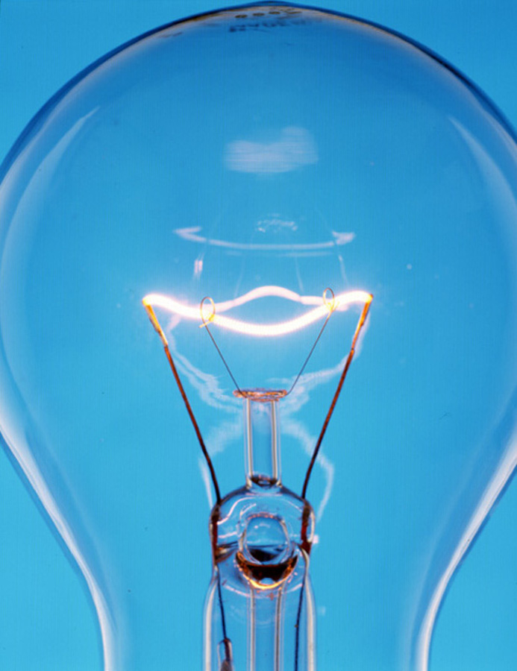
Atoms Can Be Identified by the Light They Emit
When atoms absorb energy (from heat or electricity) that atom is temporarily energized and will emit light.

Slide 18
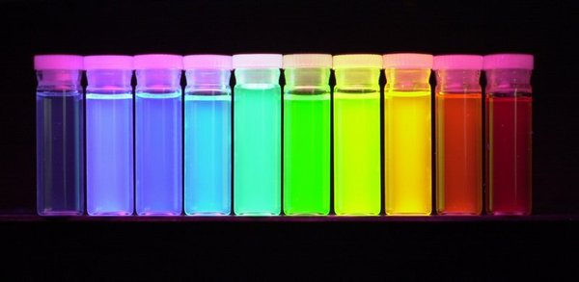
Atoms Can Be Identified by the Light They Emit
The atoms of a particular element can emit only certain frequencies (colors) of light.
As a result, each element produces its own distinct glow when energized.

Slide 19
Atoms Can Be Identified by the Light They Emit
Na atoms emit bright yellow light. That is why they are often used for street lamps.
Ne atoms emit very bright red-orange light.
Specific elements are used in fireworks to give them their colors.

Slide 20
Atoms can be identified by the light emit.
A spectroscope helps us see the individual color components of light.
When we view light from glowing atoms through a spectroscope, we see that the light consists of separate frequencies rather than a continuous spectrum (like we see with a prism).
The pattern of frequencies formed by a given element is referred to as that element’s atomic spectrum.

Slide 21
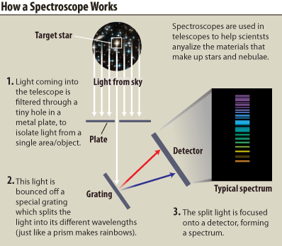

Slide 22
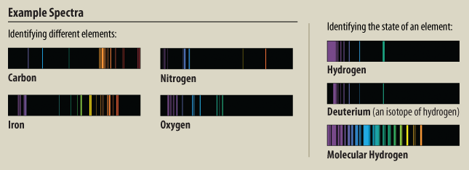
Atoms can be identified by the light emit.
The atomic spectrum is like an element’s “barcode”. No two elements have exactly the same spectrum, so you can identify what an element is by the light it emits.
Here are the atomic spectrums for some common elements:

Slide 23
Bohr’s Model of the hydrogen atom
Bohr studies the spectrum of excited hydrogen atoms and proposed the following…
When an electron is close to the nucleus of the atom → ground state
Further away from the nucleus→ excited state
Absorption of energy increases the PE of the electron as it moves further away from nucleus
An electron of excited atom absorbs energy in the form of heat or electricity to jump

Slide 24
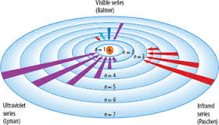
Bohr model of hydrogen

Slide 25
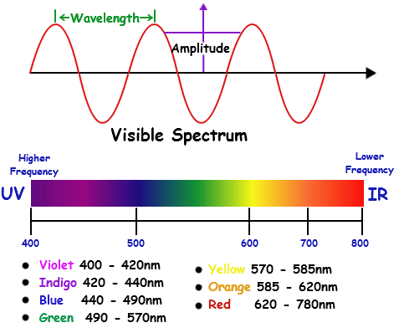
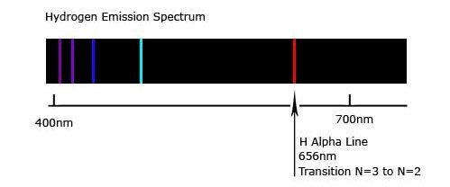

Slide 26
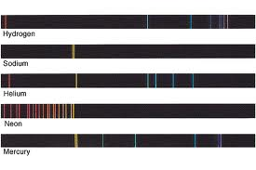
Atoms can be identified by the light emit.
Here are some other element’s atomic spectra:

Slide 27
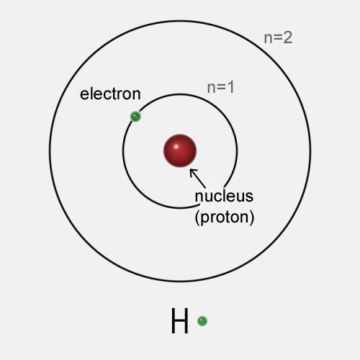
Bohr’s model
Bohr went a bit further and developed a model to reflect how an electron moving around the nucleus is restricted to certain distances from the nucleus.
That distance determines the amount of energy an electron has.
This looks a lot like planets held in orbit around the sun, so this model of the atom became known as Bohr’s planetary model.

Slide 28
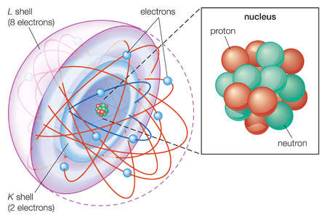
The Shell Model
According to this model, electrons behave as though they are arranged in concentric shells.

Slide 29
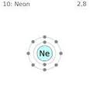
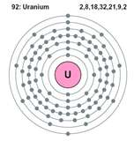
The Shell Model
An important aspect of this model is that each shell can only hold a limited number of electrons.
The innermost shell can hold 2 electrons.
The second and third can hold 8 each.
The fourth and fifth, 18 each.
The sixth and seventh, 32 each.

Slide 30
Problems with Bohr’s Model
Remember no model is a perfect representation. We use them to help us physically, or conceptually, understand something better.
However, all models have limitations.
Problems with Bohr’s Model:
It only explained the line spectrum for hydrogen because it only has one electron
He couldn’t explain why the electrons, which he pictured as circling the nucleus like tiny planets, did not fall into the nucleus every time they emitted light

Slide 31
Bohr model tutorial
http://www.youtube.com/watch?v=Ic8OnvRonb0&safety_mode=true&persist_safety_mode=1&safe=active
Bohr model explanation.
http://www.youtube.com/watch?v=CUk3enr-m0w&safety_mode=true&persist_safety_mode=1&safe=active
very good video on bohr model.
http://www.youtube.com/watch?v=QI50GBUJ48s&safety_mode=true&persist_safety_mode=1&safe=active

Slide 33
1) Which three of the lettered changes indicate absorption of energy by the atom?

Slide 34
2) Which three of the lettered changes indicate emission (loss) of energy by the atom?

Slide 35
3) Of the three energy changes that involve emission , one results in the emission of blue light, one results in yellow light, and one results in ultraviolet light.
a. Which lettered change involves the emission of blue light? ____
b. Which lettered change involves the emission of yellow light? ____
c. Which lettered change involves the emission of ultraviolet light? ____

