Slide 1
Classification of Matter
Chapter 2
The majority of these notes are to be completed free-hand, not fill-in-the blank.
Please employ good note taking skills.
For instance…
Don’t copy EVERYTHING down. Rather, paraphrase.
If something is mentioned verbally, that you don’t see on the power point, ADD IT to your notes!
Diagrams can be helpful when you refer to your notes in the future ☺

Slide 2
Everything in the universe is either matter or energy

Slide 3
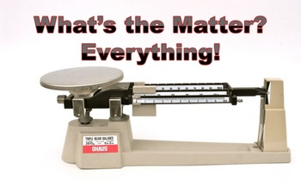
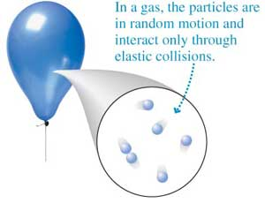
What is Matter?
1) Anything that has mass and volume
Even air, and gases less dense than air such as helium.

Slide 4
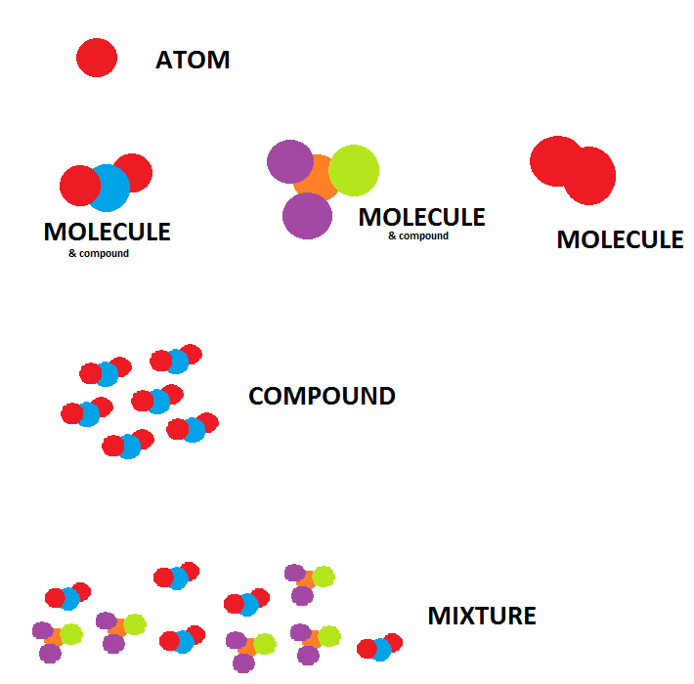
What is Matter?
2) Made of atoms (basic units of matter), molecules, or compounds (natural groups of atoms held together by bonds).

Slide 5
What is Matter?
3) Common states of matter are…
- Solid
- Liquid
- Gas
- Aqueous (dissolved in water)
Credit: Encyclopedia Brittanica, inc.

Slide 6
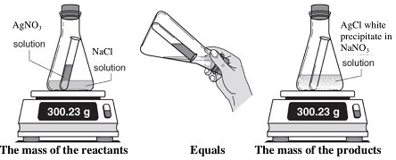
What is Matter?
4) Matter, like energy, is neither created nor destroyed → Law of Conservation of Matter

Slide 7
How do we describe matter?
Physical Properties
What is it like by itself?
Color and appearance
Density
Melting Point
Boiling Point
Chemical Properties
What does it do when reacted with other matter?
During a chemical change, composition of matter always changes. What are the final products?

Slide 8
How do we classify matter? (a flow chart)
Pure Substances:
Composed of one kind of atom, molecule, or formula unit. Cannot be separated any further into other substances.
Mixtures:
Made up of two or more pure substances physically mixed together.

Slide 9
How do we classify matter? (a flow chart)
Pure Substances:
Composed of one kind of atom, molecule, or formula unit. Cannot be separated any further into other substances.
Elements (atoms):
Simplest pure substances
Ex: H, Li, Na, Cu
Compounds:
Elements that are chemically compound in fixed ratios
Single atoms
Diatomic elements:
Occur naturally in pairs
Ex.: O₂, H₂
Ionic Compounds:
Atoms joined by + and – charges (ions). Ex: NaCl
(formula units)
Covalent
Compounds:
Atoms joined by sharing of electrons.
Ex.: H₂O
(molecules)

Slide 10
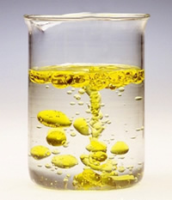
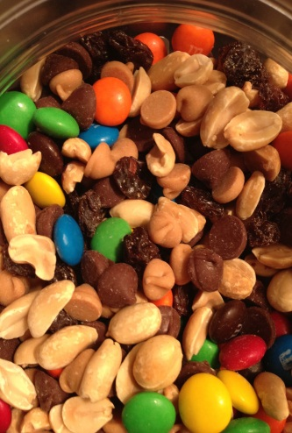
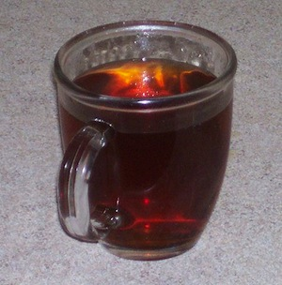
How do we classify matter? (a flow chart)
Mixtures:
Made up of two or more pure substances physically mixed together.
Heterogeneous:
Mixture in which substances are NOT evenly distributed. Composition is NOT UNIFORM.
Homogeneous:
Mixture in which substances are EVENLY distributed. Composition is UNIFORM.
Colloid:
Suspension mixtures of 2 phases. Particles in suspension will settle when centrifuged.

Slide 11
Answers: Classification of matter practice

Slide 12
HOMEWORK

