Slide 1
October 14
DO NOW:
Announcements:
If you received a check (7.5/10) on the percent error W.S.
That is being modified to a check + (10/10) in Skyward.
Important Dates: (that means…write it down in your calendar)

Slide 2
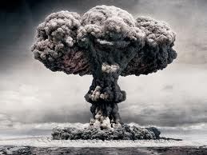
How does this happen?!?

Slide 3
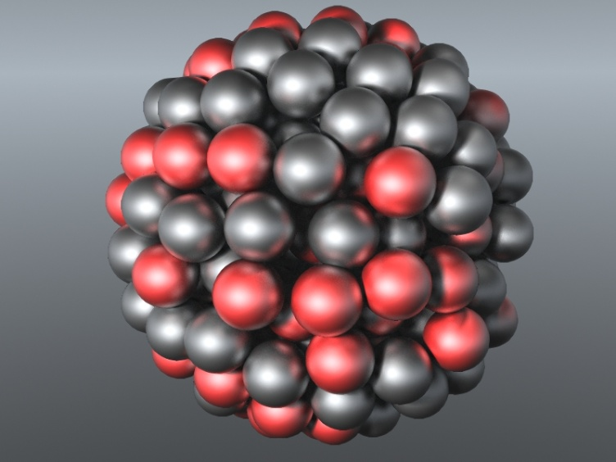
As you learned during the previous lecture…
It all deals with the forces inside the nucleus of an atom!
Remember that a nucleus is just made up of + protons and neutral neutrons.
Neutrons help hold the protons of the nucleus together, but another attractive force is also needed!
This is called the strong nuclear force, which acts between all nucleons.

Slide 4
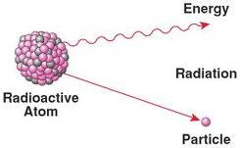
The strong nuclear force decays over distance though, so a large nucleus is not as stable as a small one.
These result in radioactive elements, that lose protons over time.

Slide 5
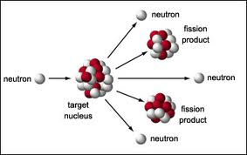
Nuclear Fission
When nuclei of certain isotopes (typically larger) are bombarded with neutrons, they undergo FISSION, the splitting of the nucleus into smaller fragments.
When you do this, the strong nuclear forces keeping all the nucleons together are released as energy.

Slide 6
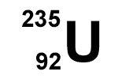
Nuclear Fission
There are only two fissionable isotopes.
Draw the symbols for each below its name.
Uranium-235 Plutonium-239

Slide 7
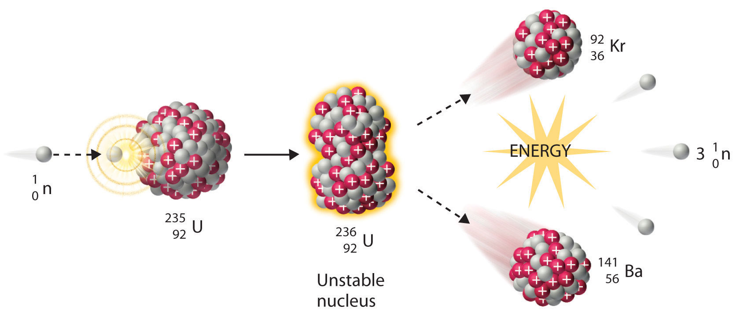
Fission of Uranium
Can you write the equation for this reaction???

Slide 8
Fission of Uranium
Notice that there the same numbers of protons on each side
HOW MANY?
92
And the same number of neutrons on each side
HOW MANY?
144

Slide 9
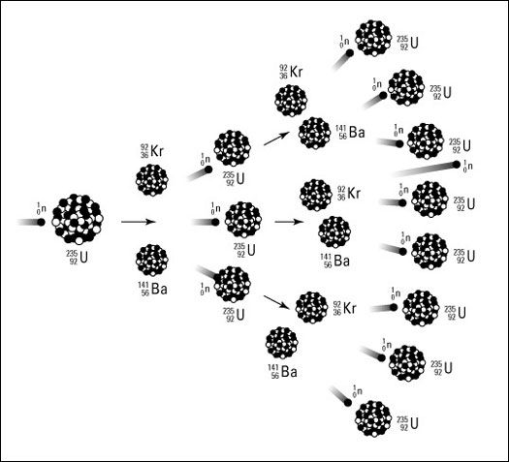
Nuclear Fission
In a chain reaction some of the neutrons released react with other fissionable atoms, releasing more neutrons which react with still more fissionable atoms.

Slide 10
Nuclear Fission
An atomic bomb is a device that starts and uncontrolled nuclear chain reaction.
To be used for energy, fission must be controlled so that energy is released more slowly.

Slide 11
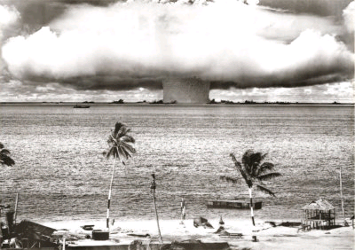
Nuclear Fission & Energy
If you multiplied 7 kilograms of Uranium by the speed of light squared, you get about 2.1 billion Joules of energy.
By comparison, a 60-watt light bulb produces 60 Joules of energy per second.
2.1 billion Joules is the amount of energy contained within a million gallons of gasoline.
What you should get out of this is that a baseball size of Uranium has a much energy as a 50 by 50 foot room full of gasoline!!

Slide 12
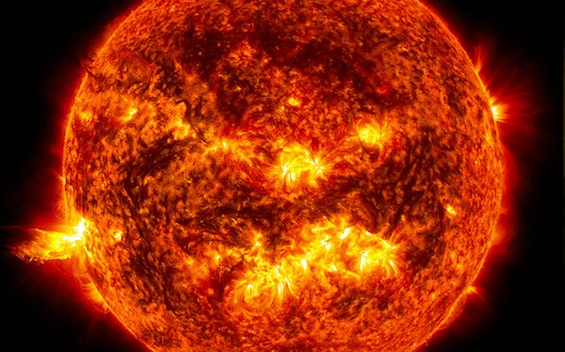
Nuclear Fusion
Nuclear fusion can be thought of as the opposite of nuclear fission, that is small nuclei combine to produce a nucleus with a greater mass.
This releases much more energy that a fission reaction, but only happens above 40,000,000 ⁰C
Happens during life cycles of stars!
In fact, elements 1-20 were formed this way.

Slide 13
Nuclear Fusion
Write the formula for 4 hydrogen nuclei combining to create one helium nucleus:

Slide 14
HOMEWORK

