Slide 1
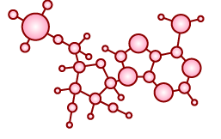
Four processes were needed for the spontaneous origin of life on Earth:
Non-living synthesis of simple organic molecules
Assembly of these molecules into polymers

Slide 3
Assembly of these molecules into polymers 4 hypothesized locations:
Ocean-land interface hypothesis
Under hypothesis
Clay hypothesis
Hydrothermal vent hypothesis

Slide 4
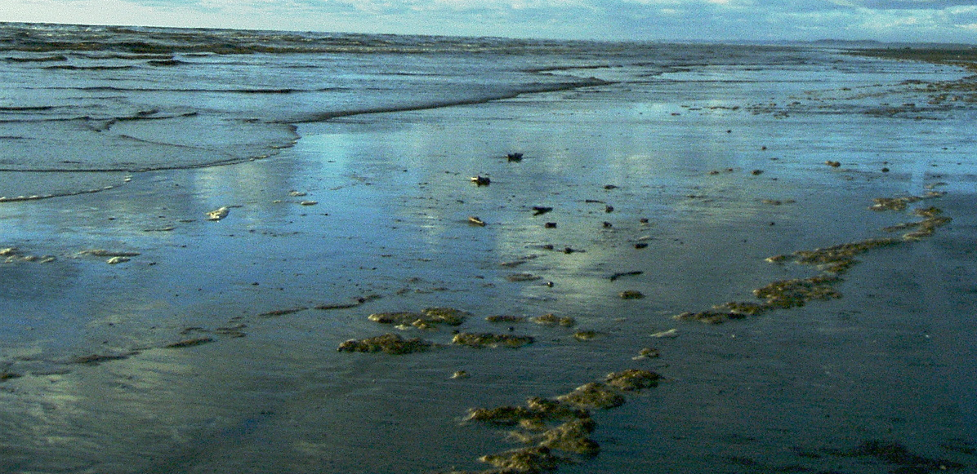
Ocean-Land Interface Hypothesis
Early oceans carried simple organic molecules
The porous surfaces of shoreline minerals helped organize such building blocks into polymers.
Notes:
Perhaps the leading theory focuses on the slimy interface where the sea laps against land. If early oceans carried organic molecules—and they most likely did—the porous surfaces of shoreline minerals could have helped organize such building blocks into primitive structures.

Slide 5
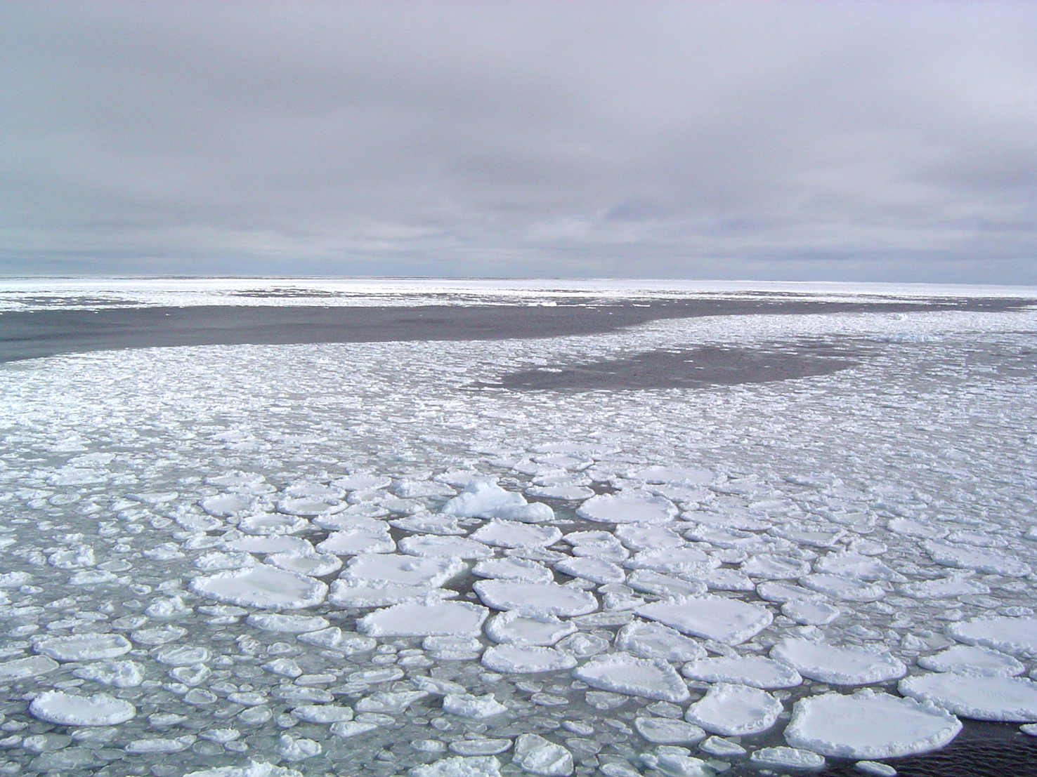
Under Ice Hypothesis
Some scientists calculate that at one point, the top 300 meters of the ocean were frozen over.
Notes:
According to some solar evolution models, the sun was some 30 percent dimmer at that time, providing less heat to Earth. So as soon as the hail of asteroids stopped, Earth may have cooled to an average surface temperature of –40°F and a crust of ice as much as 1,000 feet thick may have covered the oceans.
You might think that icy cold water trapped under hundreds of meters of ice would not be beneficial to life beginning, but in fact it is advantageous in many aspects. One advantage is that the layer of ice would provide a protective shield by preventing ultra-violet light, which enters the earth's atmosphere and destroys organic compounds, from reaching the developing molecules. Another advantage is that it would provide safety from the devestating effects of impact frustration. ( Definition Box -Impact frustration is a theory which says that life may potentially have arisen many times, but was wiped out due to severe bolide impacts) The water beneath the ice would be cold, allowing for organic molecules to survive over much longer periods of time. These organic molecules could have been provided by the hydrothermal vents still prevalent on the ocean floor today. With a sufficient supply of organic molecules safe from ultra-violet radiation and bolide impact frustration, many believe that this was the environment allowing life to get a foothold on a hostile earth.
With a barrier between the atmosphere and the ocean, the debate concerning the composition of the atmosphere becomes much less significant. All of the components needed for organic syntheses such as the Strecker synthesis would be provided and kept stable, while the bottom of the ocean would provide a place for organics to gather and react. Following this reasoning, the atmospheric composition may only be important after life came out of the water, when life had already begun.

Slide 6
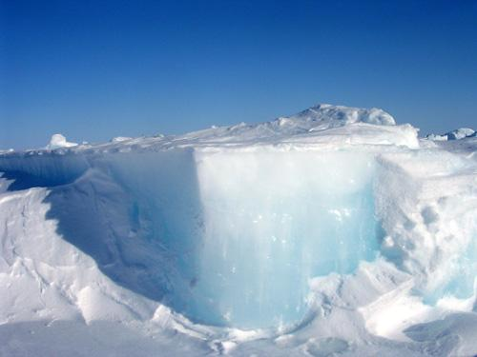
Ice provided a protective shield from UV light (which destroys organic compounds)
Organic compounds are more stable in colder temperatures and could combine in a lattice of ice.
Notes:
You might think that icy cold water trapped under hundreds of meters of ice would not be beneficial to life beginning, but in fact it is advantageous in many aspects. One advantage is that the layer of ice would provide a protective shield by preventing ultra-violet light, which enters the earth's atmosphere and destroys organic compounds, from reaching the developing molecules. Another advantage is that it would provide safety from the devestating effects of impact frustration. ( Definition Box -Impact frustration is a theory which says that life may potentially have arisen many times, but was wiped out due to severe bolide impacts) The water beneath the ice would be cold, allowing for organic molecules to survive over much longer periods of time. These organic molecules could have been provided by the hydrothermal vents still prevalent on the ocean floor today. With a sufficient supply of organic molecules safe from ultra-violet radiation and bolide impact frustration, many believe that this was the environment allowing life to get a foothold on a hostile earth.
With a barrier between the atmosphere and the ocean, the debate concerning the composition of the atmosphere becomes much less significant. All of the components needed for organic syntheses such as the Strecker synthesis would be provided and kept stable, while the bottom of the ocean would provide a place for organics to gather and react. Following this reasoning, the atmospheric composition may only be important after life came out of the water, when life had already begun.
Proposed by Miller’s graduate student. He was looking at samples from the Miller experiment that had been frozen for 25 years and he actually saw the percentage of some compounds had increased in the sample.
The skepticism they faced was understandable. Chemical reactions do slow down as the temperature drops, and according to standard calculations, the reactions that assemble cyanide molecules into amino acids and nucleobases should run a hundred thousand times more slowly at –112°F than at room temperature. This is the main argument against Miller’s experiment, and against a cold origin of life in general. But strange things happen when you freeze chemicals in ice. Some reactions slow down, but others actually speed up—especially reactions that involve joining small molecules into larger ones. This seeming paradox is caused by a process called eutectic freezing. As an ice crystal forms, it stays pure: Only molecules of water join the growing crystal, while impurities like salt or cyanide are excluded. These impurities become crowded in microscopic pockets of liquid within the ice, and this crowding causes the molecules to collide more often. Chemically speaking, it transforms a tepid seventh-grade school dance into a raging molecular mosh pit.

Slide 7
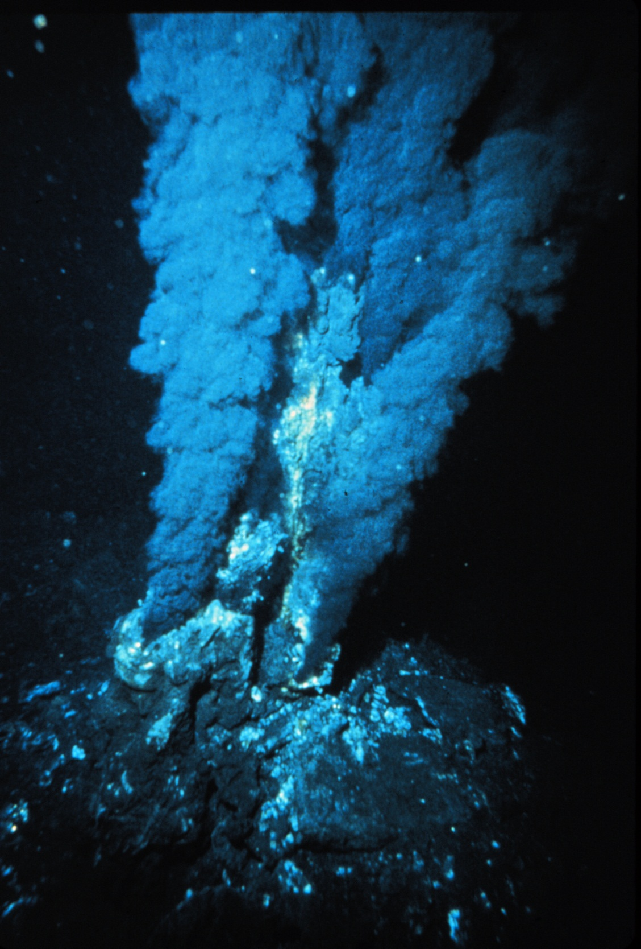
Hydrothermal Vent Hypothesis
Release hot gaseous substances which may fuel polymerization
Today, they are surrounded by thriving ecosystems
VIDEO
Notes:
One current theory is that life originated deep beneath the surface of the ocean at deep sea hydrothermal vents. These hydrothermal vents were first discovered in 1979. Soon after, scientists made an exciting discovery. These vents release hot gaseous substances from the center of the earth at temperatures in excess of 700oF. Previously scientists were sure that life could not exist, deep beneath the surface of the ocean. After the discovery of hydrothermal vents, they found ecosystems thriving in the depths of the ocean. These ecosystems contained various types of fish, worms, crabs, bacteria and other organisms which had found a way to survive in a cold, hostile environment without energy input from sunlight. Because life had been found to exist where it previously was thought unable to, many scientists began to ask questions as to whether or not this was where life may have originated on the earth.

Slide 8
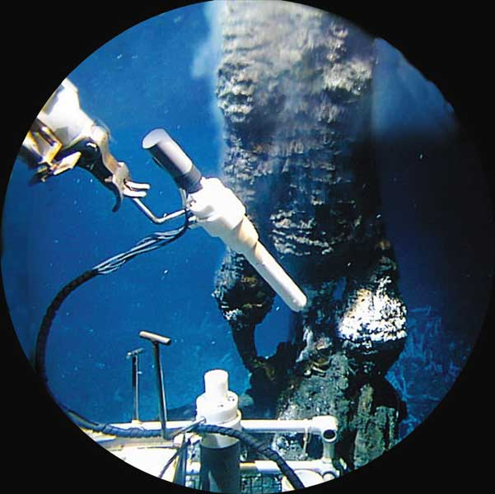

Slide 9
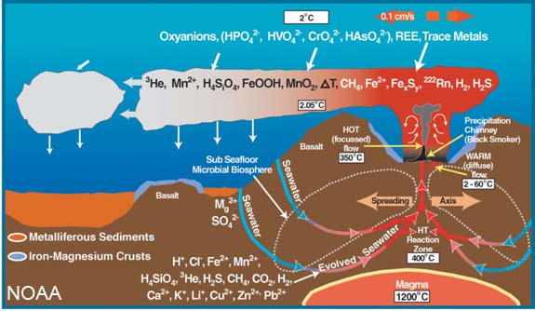
Hydrothermal Vent Hypothesis
Notes:
On the molecular level, the chances of life originating at deep sea thermal vents is not likely. It is known that organic molecules are unstable at high temperatures, and are destroyed as quickly as they are produced. It has been estimated that life could not have arisen in the ocean unless the temperature was less than 25oC, or 77oF.
Supporters of this theory claim that the organic molecules at the thermal vents are not formed in 300oC temperatures, but rather in a gradient formed between the hydrothermal vent water, and the extremely cold water, 4oC (39.2oF), which surrounds the vent at the bottom of the ocean. The temperatures at this gradient would be suitable for organic chemistry to occur. Debates still remain, however, as to the gradient's effectiveness in producing organic compounds.

Slide 10
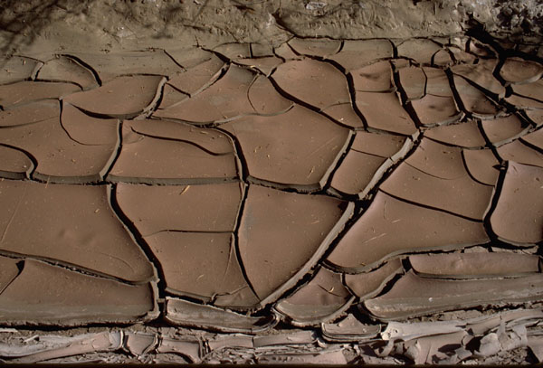
Clay Hypothesis
Clay contains iron and zinc atoms which can serve as inorganic catalysts for polypeptide formation
Clay collects energy from radioactive decay and discharges it if temperature or humidity changes; could have been source of energy for polymerization to take place
VIDEO

