Slide 1
Why is the cell the basic unit of life?

Slide 2
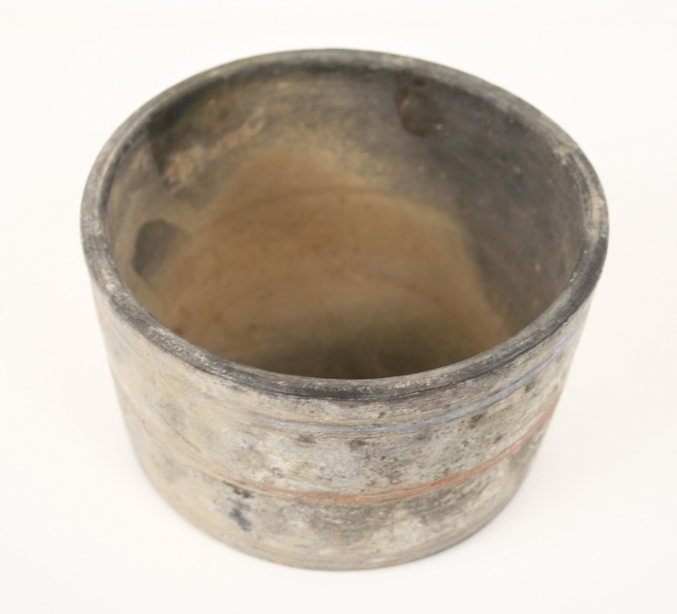
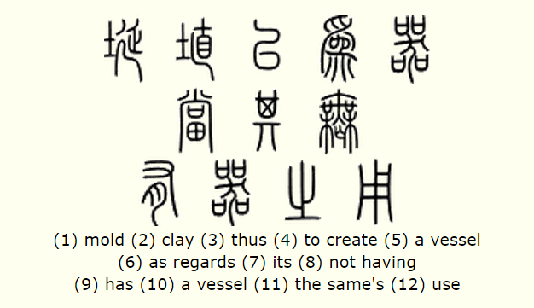
EMERGENT
PROPERTIES
“ Pots are fashioned from clay but it's the hollow that makes a pot work” Tao Te Ching
Han Dynasty Pot (206 BC)

Slide 3
Notes:
Display this slide while students are reading article and defining emergent properties in their own words

Slide 4
Read this article
For the definition of an emergent property
Notes:
“ we must recognize that living systems, and other high integrative levels, have new and unique properties that emerge through the combination of the lower-level units of matte”

Slide 5
Definition
Matter gets organized into different levels of complexity. At each level new characteristics are present that were not present in lower levels (properties emerge)

Slide 6
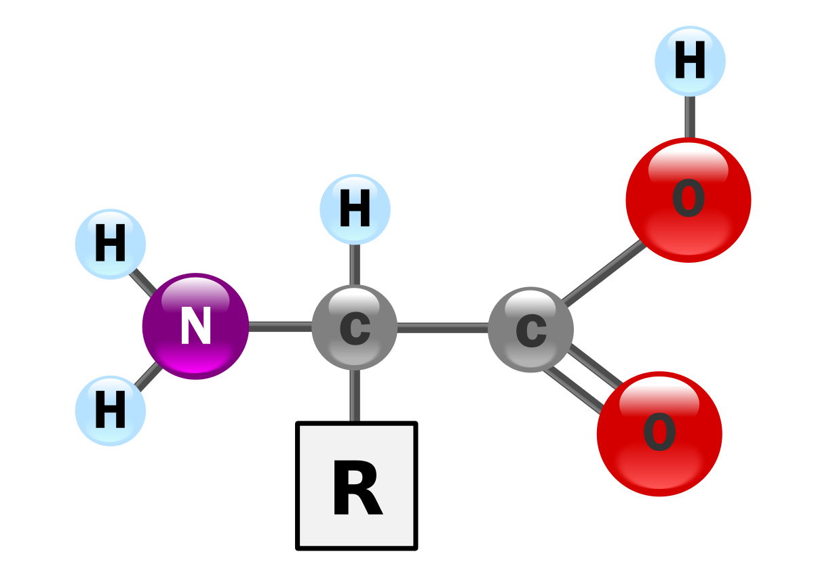
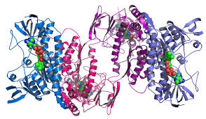
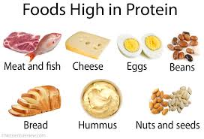
Notes:
A carbon atom on its own does not have the same properties as the Carbon when it combines with Nitrogen, Oxygen and Hydrogen to form amino acid. A single amino acid has differnet properties than when multiple come together to form a protein. As the parts (elements) come together into a whole (protein) they have different meaning/ characteristics emerge

Slide 8
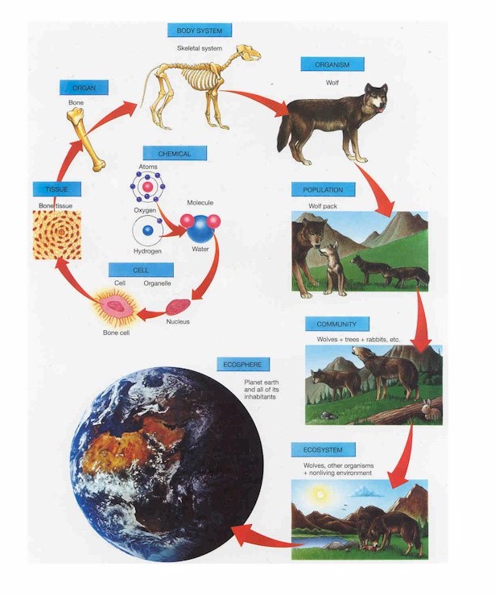
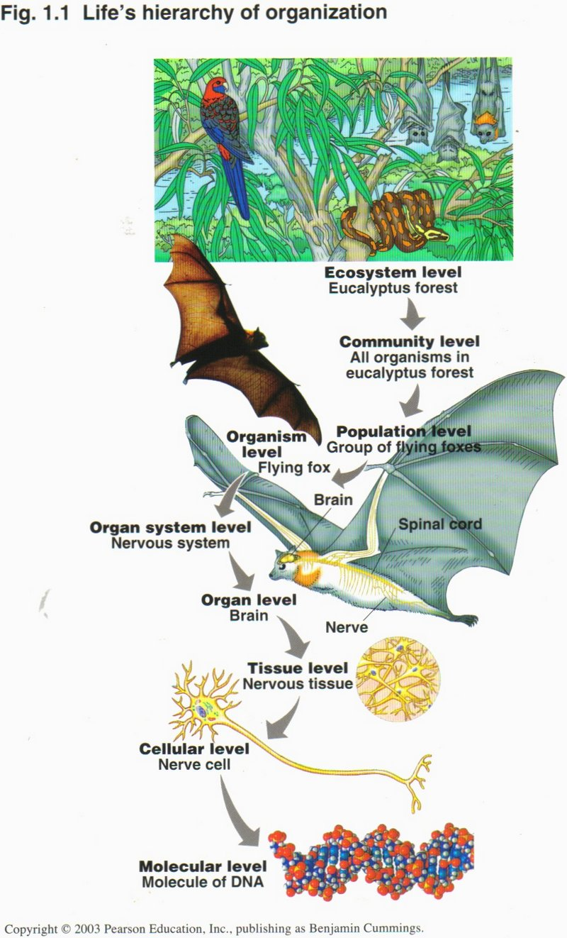

Slide 9
What properties emerge at each level?
Atoms include H, N, O, P, C, and others. Subatomic particles
When atoms come together they create molecules like Nucleic Acids, Proteins, Lipids and Carbs
Molecules can store energy in their bonds that can be broken, they can assemble together to create membranes, etc.)
Cells are the basic unit of Life so at this level 8 characteristics of life can be performed
Cells work together in tissues for a common purpose like keeping a heart beating or acting as a barrier like epithelial cells
An organ is the coming together of multiple tissues to perform a function like pumping blood or secreting enzymes to break down food
Organs working together to complete a certain bodily process like digest food or circulate blood
When all the organ systems work together, the organism can survive in a changing environment
Notes:
Cell is now living (can perform 8 characteristics of life). After this, you have multicellular organisms. Unicellular organisms are composed of only 1 cell (Paramecium, Chlamydmonas, etc.). When an organism is made of many cells it is multicellular (humans, puppies, pumpkins, etc.). Integrative levels: the organization of matter into levels based on complexity.
Tissue types include: Epithelial, Connective, Muscle, and Neural.
Organ: fun fact skin is our largest organ :0
Organ systems: Skeletal, muscular, respiratory, circulatory, nervous, digestive. etc.

Slide 10
What if a mutation occurs at the molecular level (i.e. DNA?)
Notes:
This could effect all the emergent properties to follow :0

Slide 11
In general...
Emergent properties arise from the interaction of component parts: the whole is greater than the sum of its parts
Multicellular organisms are capable of completing functions that individual cells could not undertake - this is due to the interaction between cells producing new functions
In multicellular organisms:
Cells may group together to form tissues
Organs are then formed from the functional grouping of multiple tissues
Organs that interact may form organ systems capable of carrying out specific body functions
Organ systems carry out the life functions required by an organism

