Slide 1
Describe how the letter e appeared in the microscope

Slide 2
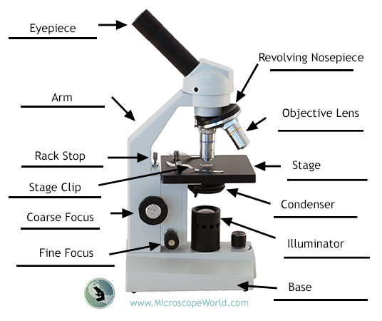
Touret (objective housing/ Revolving nosepiece)
Diaphragm
On Our Microscopes The fine focus is attached to Course focus!!!!! Use class Microscopes as reference when Labeling
Light

Slide 4
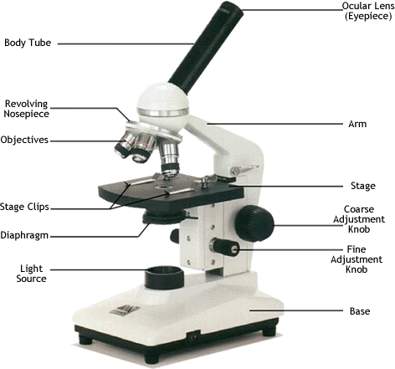
Total Magnification= Ocular x Objective Lens
The Ocular on our microscopes is 10X (ten times larger than life).
What is the total MAG under the 4X lens?
What is the total MAG under the 40X lens?
What is the total MAG under the 10X lens?
What is the total MAG under the 100X lens?
40X
400X
100X
1000X

Slide 6
What metric unit do we use to express the size of a specimen viewed under a light microscope?
Millimeters are the smallest increment on most metric rulers; it’s a tenth of a centimeter (cm).
Things we see under the microscope are much smaller than that…we use micrometers (µm) to measure them.
A µm is 1,000 times smaller than a mm.
Scale of Universe (micrometers)
Conversion Factor: 1 mm = 1,000 µm

Slide 7
Practice Conversions:
Work with a neighbor to complete the following conversions (millimeters to micrometers)
Dimensional Analysis!!!!!! Am I right or am I right?!?!?!?!
10mm= | 4.5mm= | .025mm=
5mm= | 4.25mm= | .001mm=

Slide 8
Field of View

Slide 9
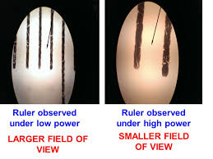
Field of View can be determined by viewing measurements under microscope
We can look under a microscope at a transparent ruler to see what the diameter of the field of view is.
How large is the field of view (FOV) under low power?
4.5mm = 4,500 µm

Slide 10
FOV can be used to estimate the size of specimens

Slide 11
FOV under higher magnifications
As you continue to increase magnification, FOV will decrease to point you may not be able to see marking on a ruler.
To calculate diameter of FOV for higher magnifications, we will use the following formula
Diameter (HP) x Magnification (HP) = Diameter (LP) x Magnification (LP)
Rearrange…
Diameter (HP)= Diameter (LP) x Magnification (LP)
Magnification (HP)

Slide 12
A student determines that the field of view with a 10X ocular and a 4X objective is 2.5 mm in diameter. What is the diameter with the same ocular and a 10X objective?
(2.5 mm)(4)= (measured diameter of low power) (low power objective mag)
(10) (Higher power objective mag)
The diameter/ field of view for 10x objective is
1mm or 1000 um

Slide 13
Example:
What is the field of view under the 40x high power objective with the same microscope from the previous problem?

Slide 14
Skyline Microscopes Quick Reference Sheet Top of page 2 of note packet
Can you fill in blanks?
40x
4.5 mm
100x
1.8 mm
400x
0.45 mm

Slide 15
Estimating the Size of the Specimen Under Observation
Estimate what fraction of the diameter of the field of vision that the object occupies.
Multiply the diameter you calculated in micrometers by that fraction
The amoeba occupies about 1/3 of the field of view.
If the field of view is 3mm (3,000µm)…
3,000µm x 1/3 = 1,000µm
The estimated size of the amoeba is 1,000µm

Slide 16
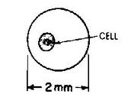
Practice
2.0 mm
How much of the FOV does the cell take up?
If the Field of View is 2.0mm, how big is your cell?
1/4
¼ X 2.0mm = 0.5mm

Slide 17
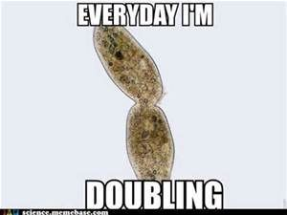

Slide 18
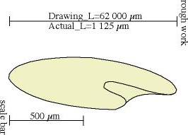
Determine the drawing magnification
Discuss with a partner how you might determine how much bigger this drawing is than the cell was under the microscope.

Slide 19
Determining Drawing Magnification
Drawing Magnification indicates how many times larger the drawing is compared to life size.
Add a scale bar to indicate the estimated or measured size of the sample.
Use following equation to determine drawing magnification.
** Make sure units are the same so that they cancel each other out.

Slide 20
If you were just given a drawing and were told the drawing magnification, Could you determine the size of the specimen?
HOW?

Slide 21
Determining Size of Specimens From Drawings/Micrographs
Re-arrange the previous formula to determine the size of a specimen.

