Slide 1
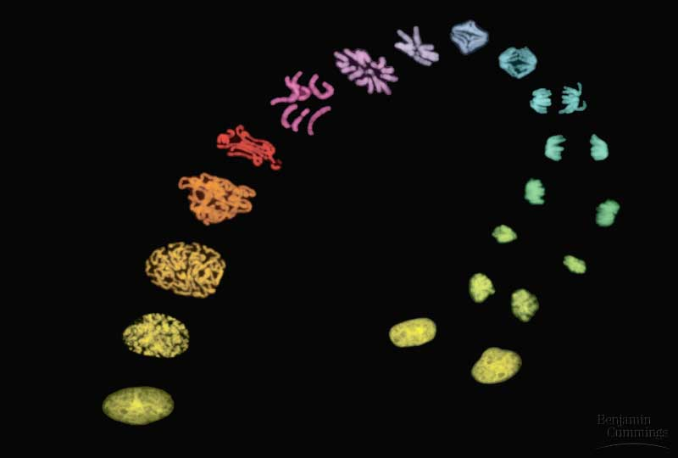
The Cell Cycle

Slide 2
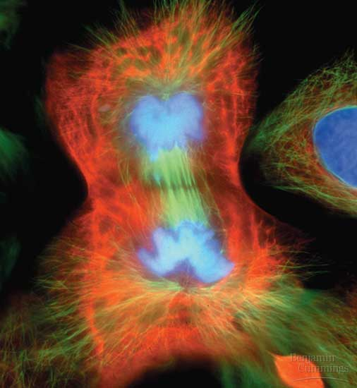
Mitosis is the division of the nucleus into two genetically identical daughter nuclei.
WHY?

Slide 3
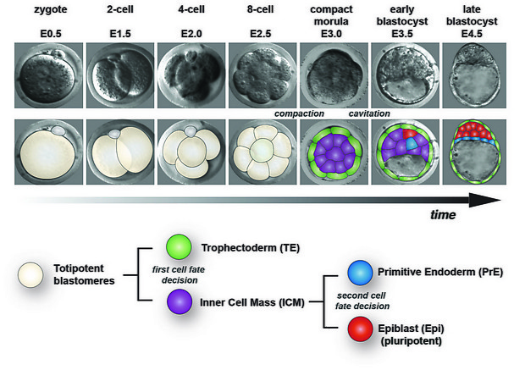
During embryonic development

Slide 4
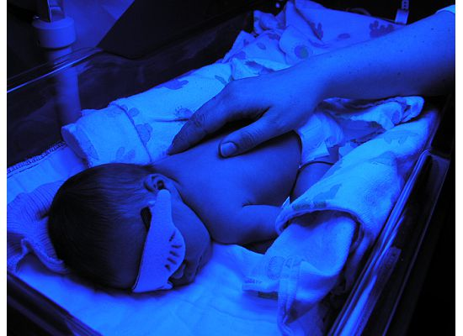
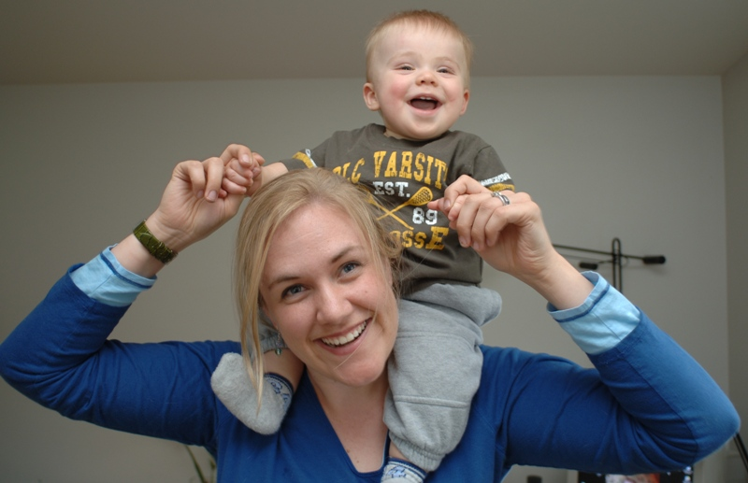
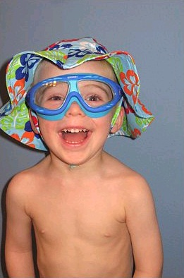
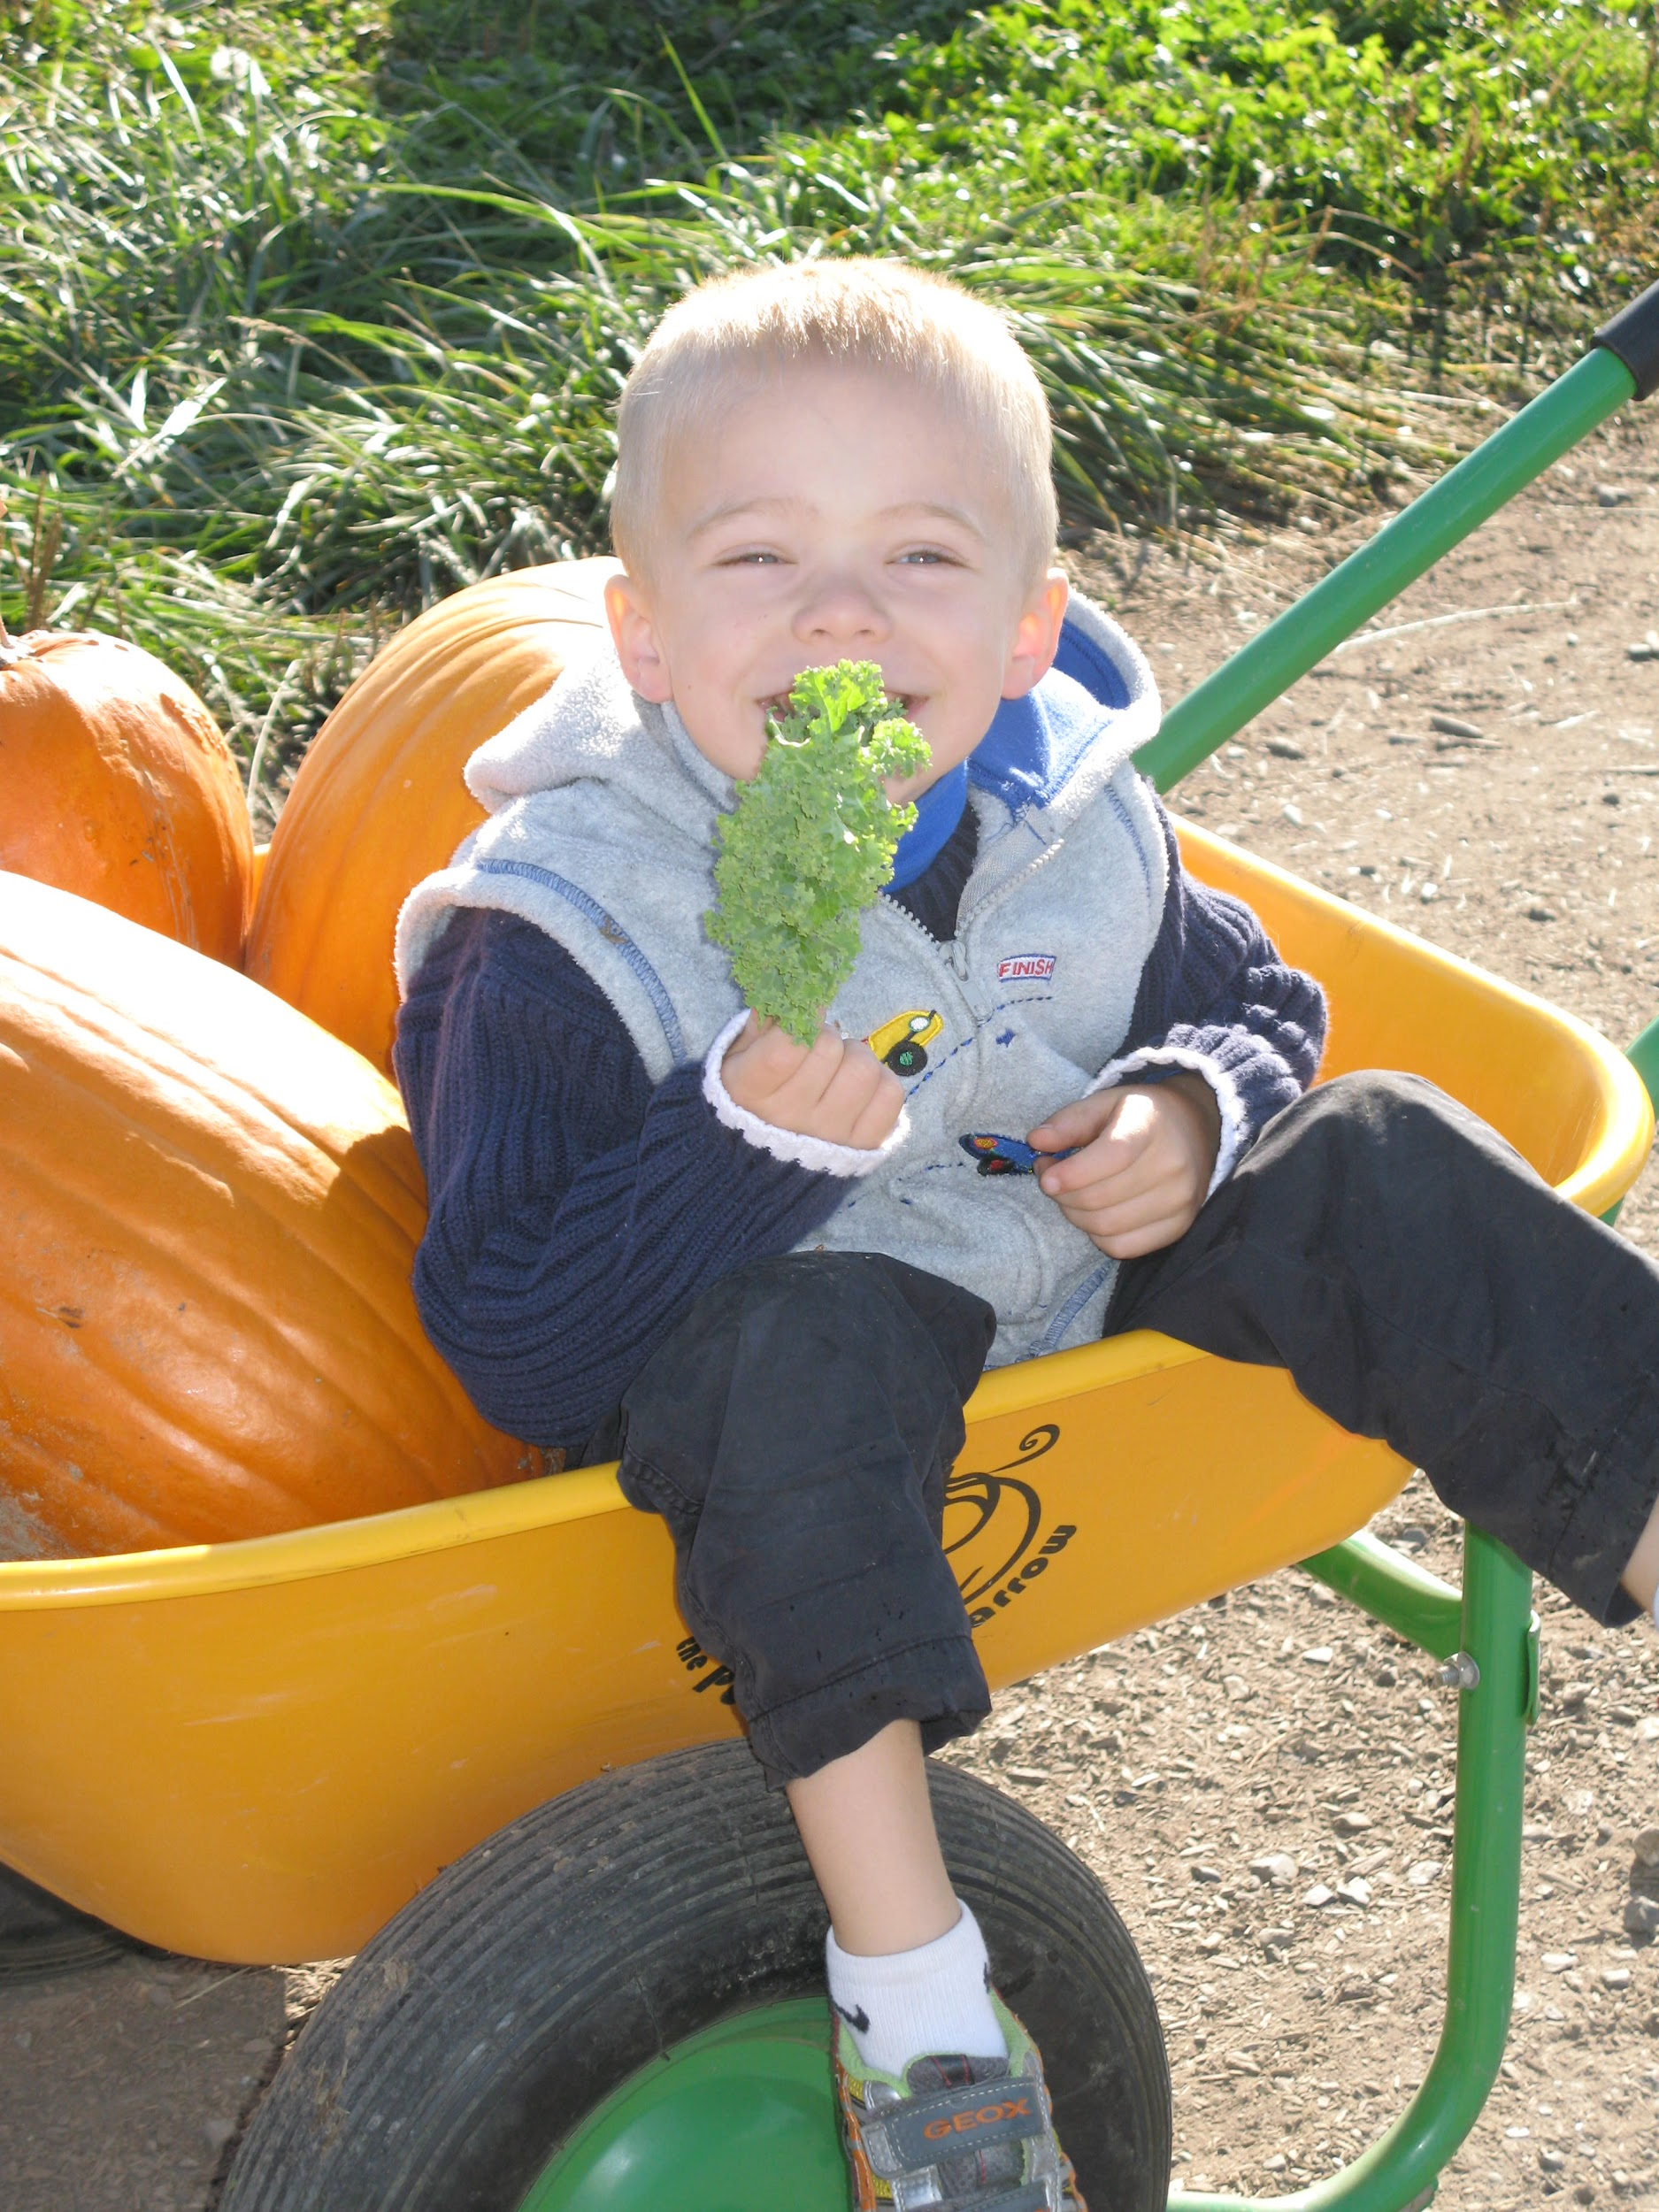
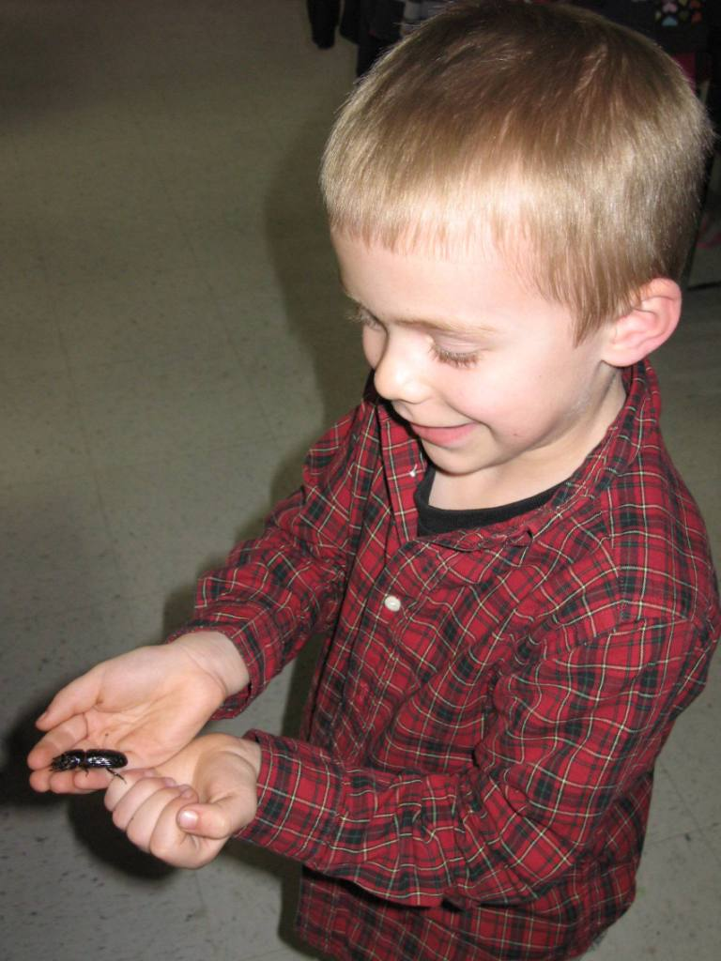
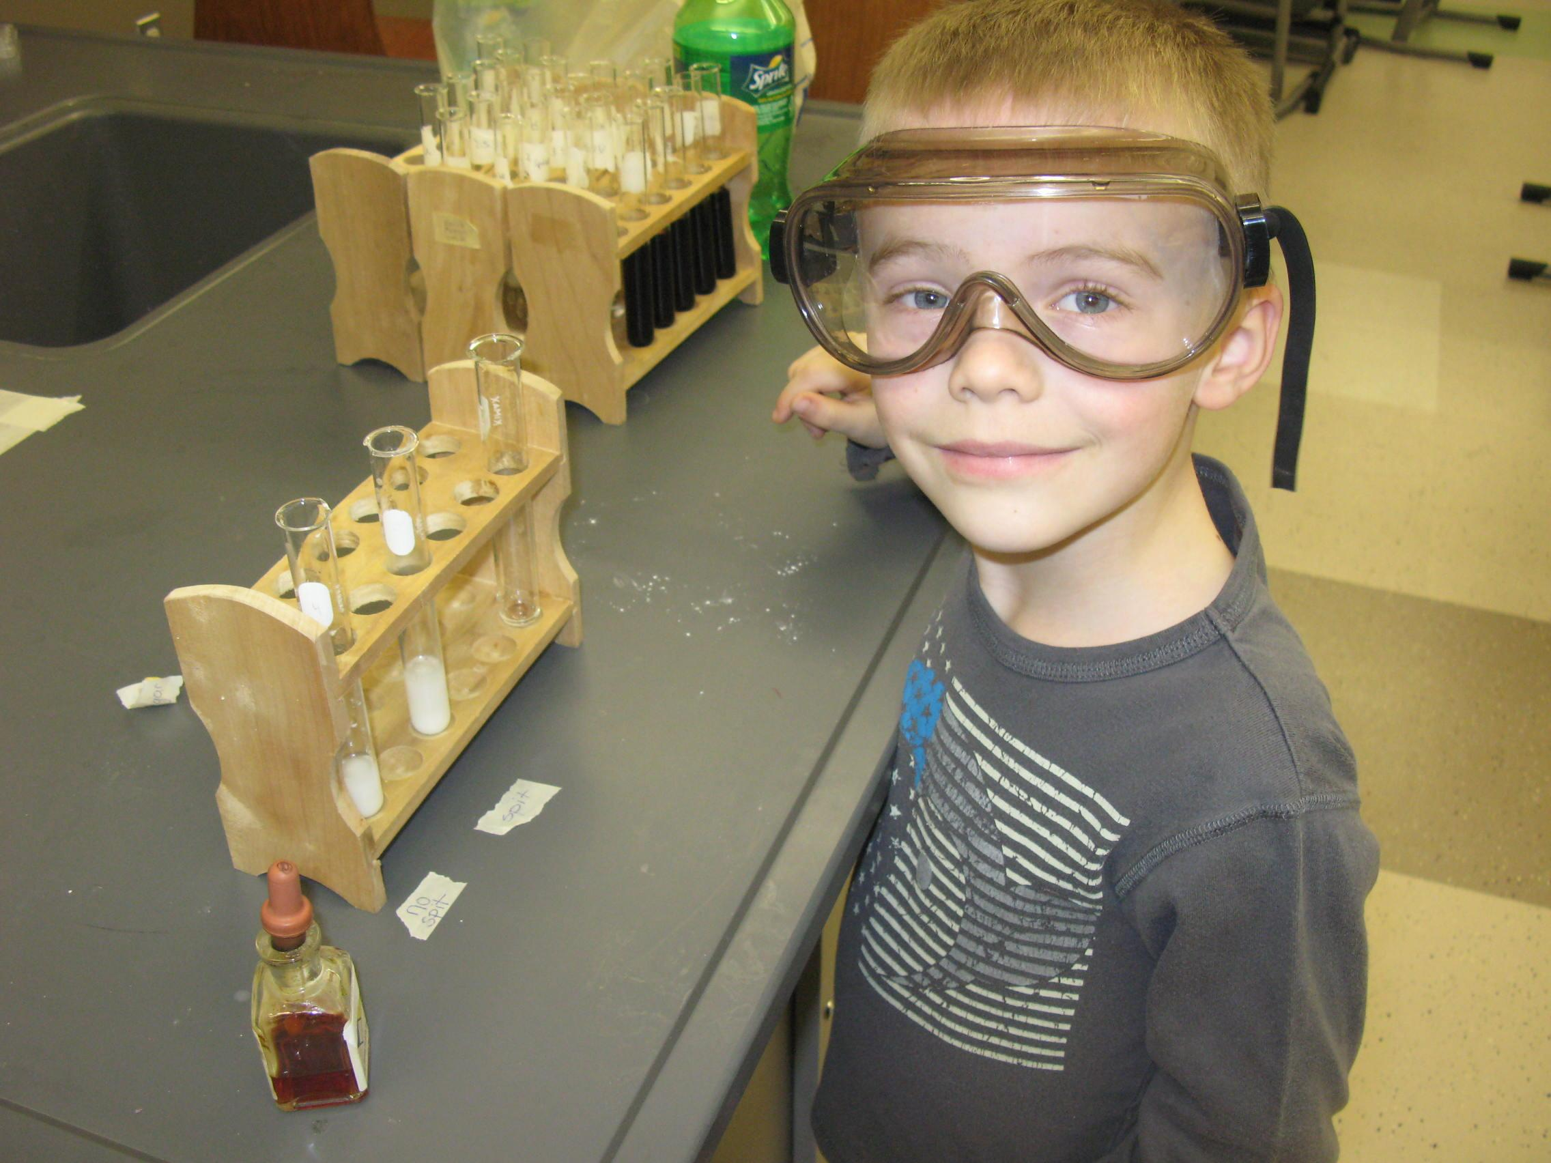
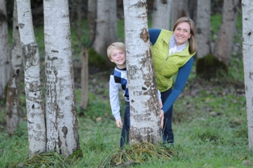
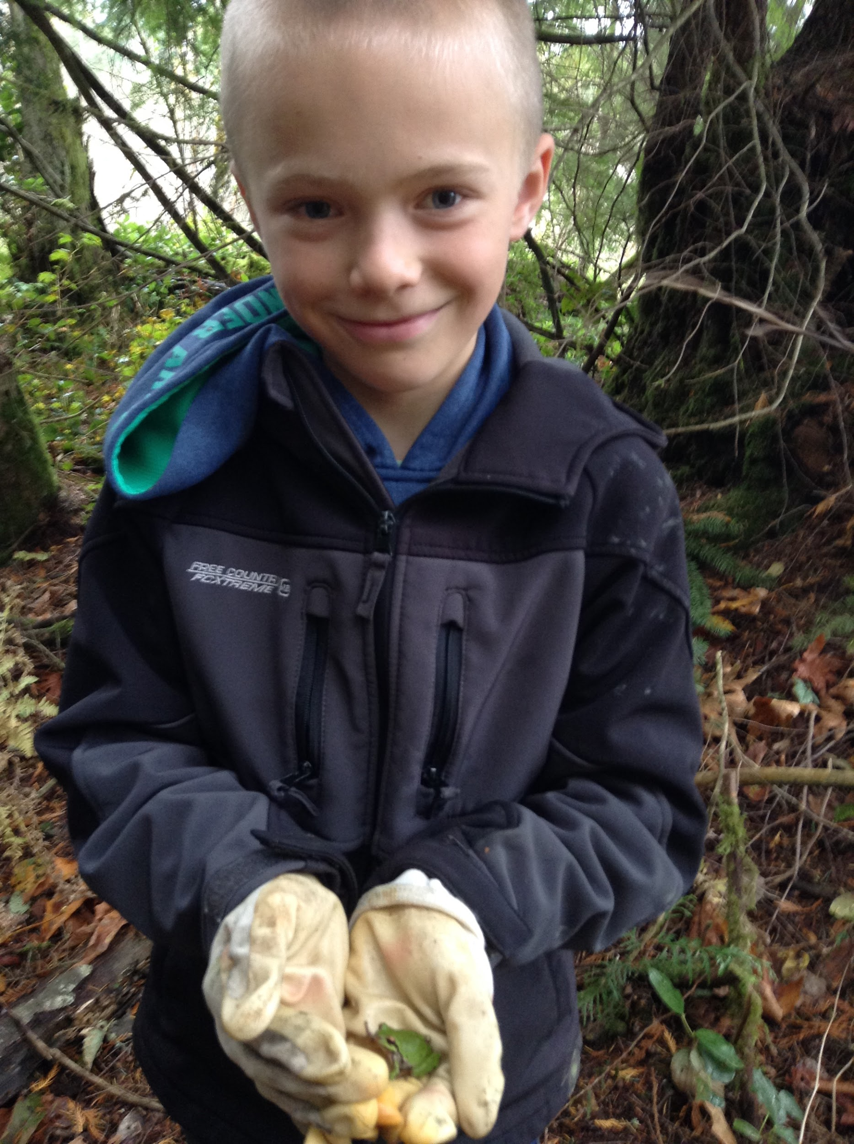
Organism Growth

Slide 5
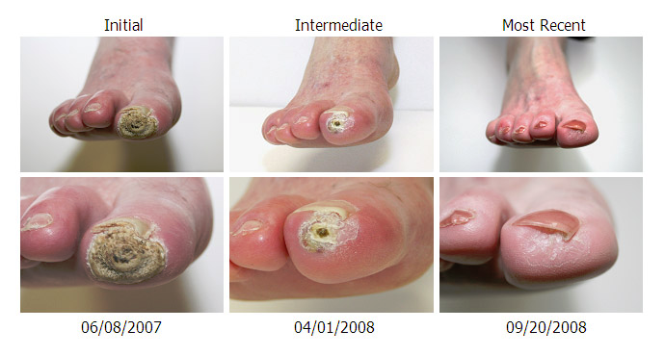
Tissue Repair

Slide 6
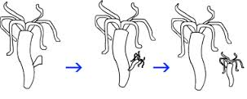
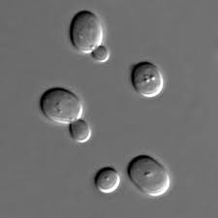
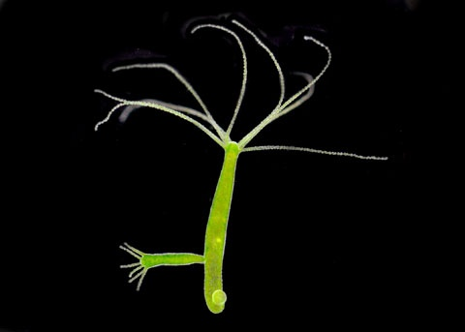
Asexual Reproduction

Slide 7
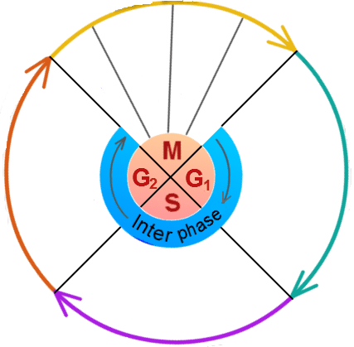
The Cell Cycle
The cell cycle is the events that take place in a cell leading to its division that produces two daughter cells.

Slide 8
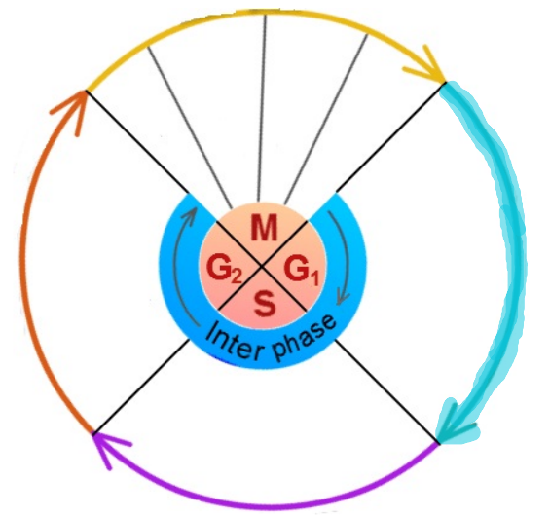
Cells performing their differentiated function
A lot of protein synthesis and metabolism is occurring
Numbers of organelles increase.
G1
First gap phase

Slide 9
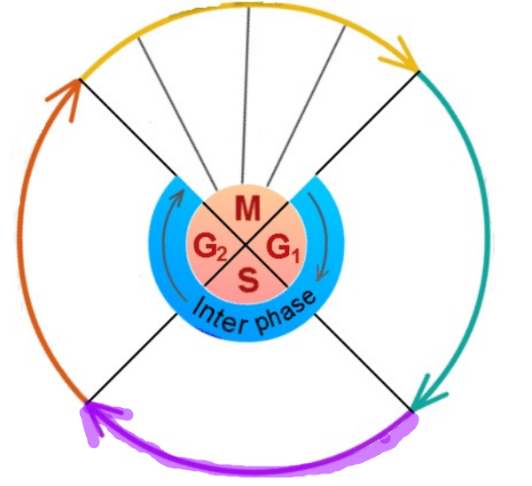
The cell replicates the DNA in the nucleus so that after mitosis both the new cells have a complete set of genes
S
Synthesis phase

Slide 10
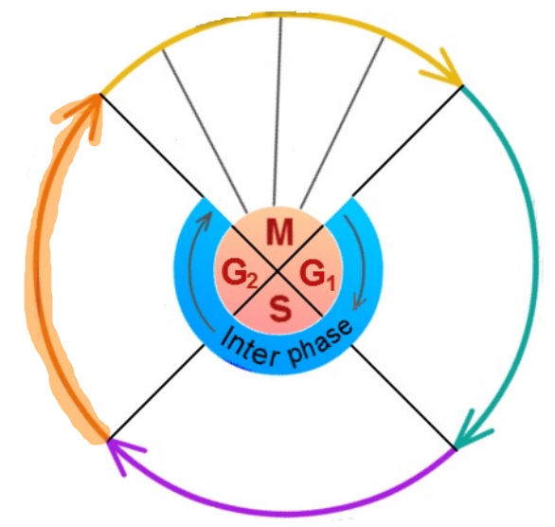
Protein synthesis and metabolism is occurring to create the molecules needed for mitosis
Numbers of organelles increase.
G2
Second gap phase

Slide 11
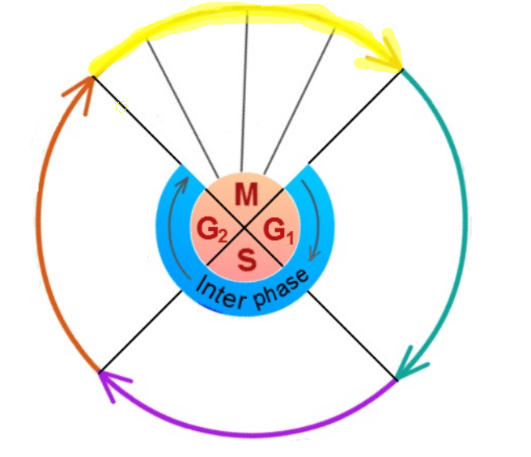
M
Mitosis
Division of the cell nucleus into two genetically identical daughter nuclei
Metaphase
Anaphase
Prophase
Telophase

