Slide 1
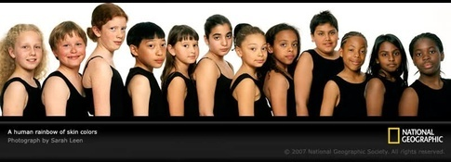
Why?
decreased
increased
increased
decreased

Slide 2
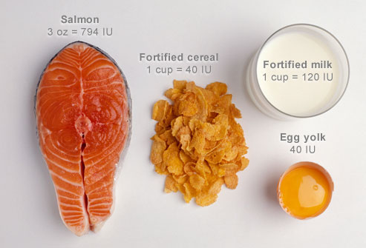
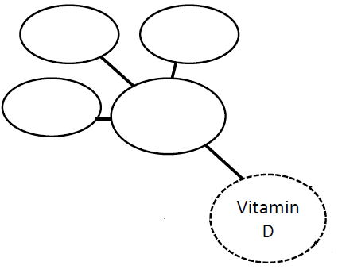
Eggs
Oily Fish
Fortified Daily and Grains
Found in some foods
Notes:
https://www.bones.nih.gov/health-info/bone/bone-health/nutrition/calcium-and-vitamin-d-important-every-age

Slide 3
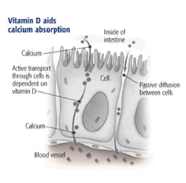
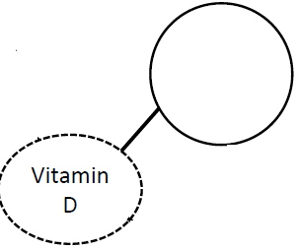
Needed for Ca²⁺ absorption for food

Slide 4
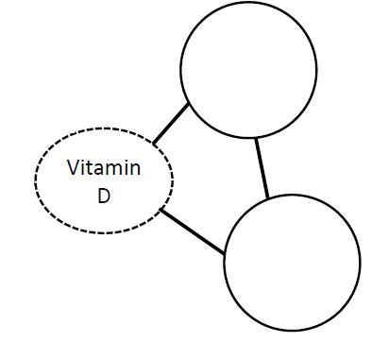
Needed for Ca²⁺ absorption for food
Not
enough...
Skeletal Deformity
“Rickets”
Not
enough...

Slide 5
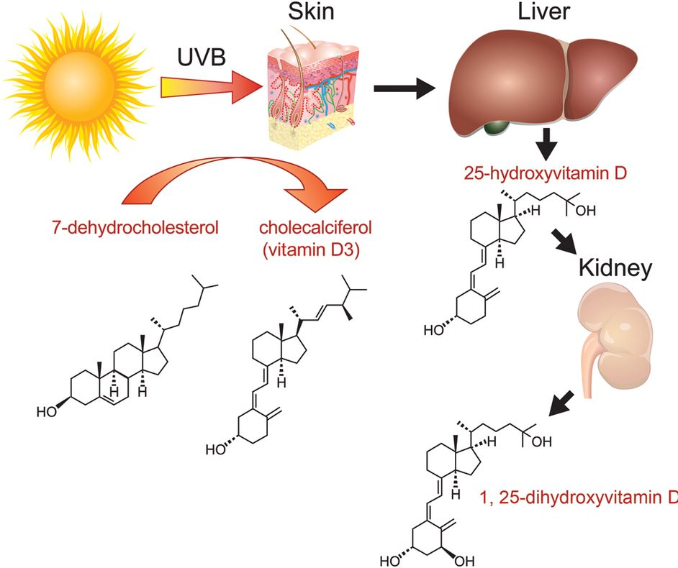
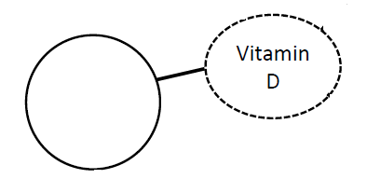
Naturally synthesized in the skin

Slide 6
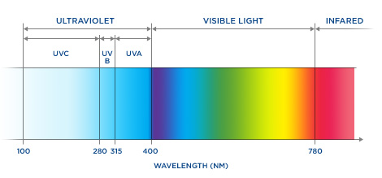
Naturally synthesized in the skin
Only with...
UV Light

Slide 7
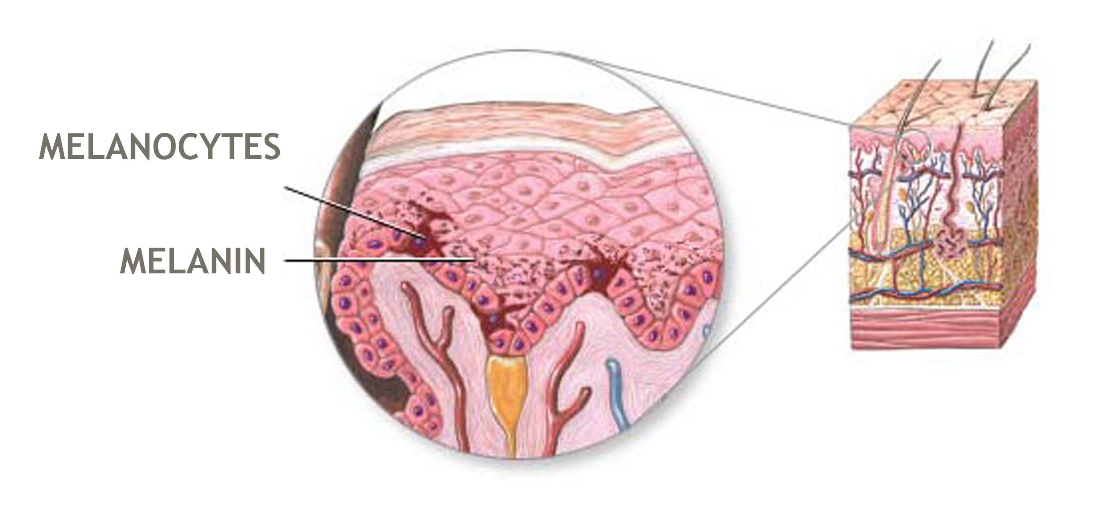
Naturally synthesized in the skin
UV Light
Is intercepted
and absorbed by ...
A skin pigment called melanin

Slide 8
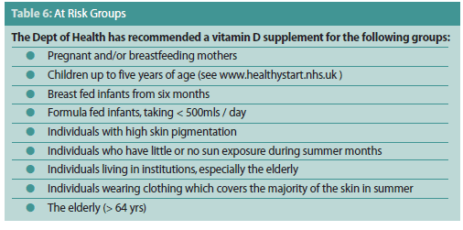
Naturally synthesized in the skin
supplements might be needed by those with darker skin pigmentation
More melanin in the skin reduces vitamin D synthesis
UV Light
A skin pigment called melanin

Slide 9
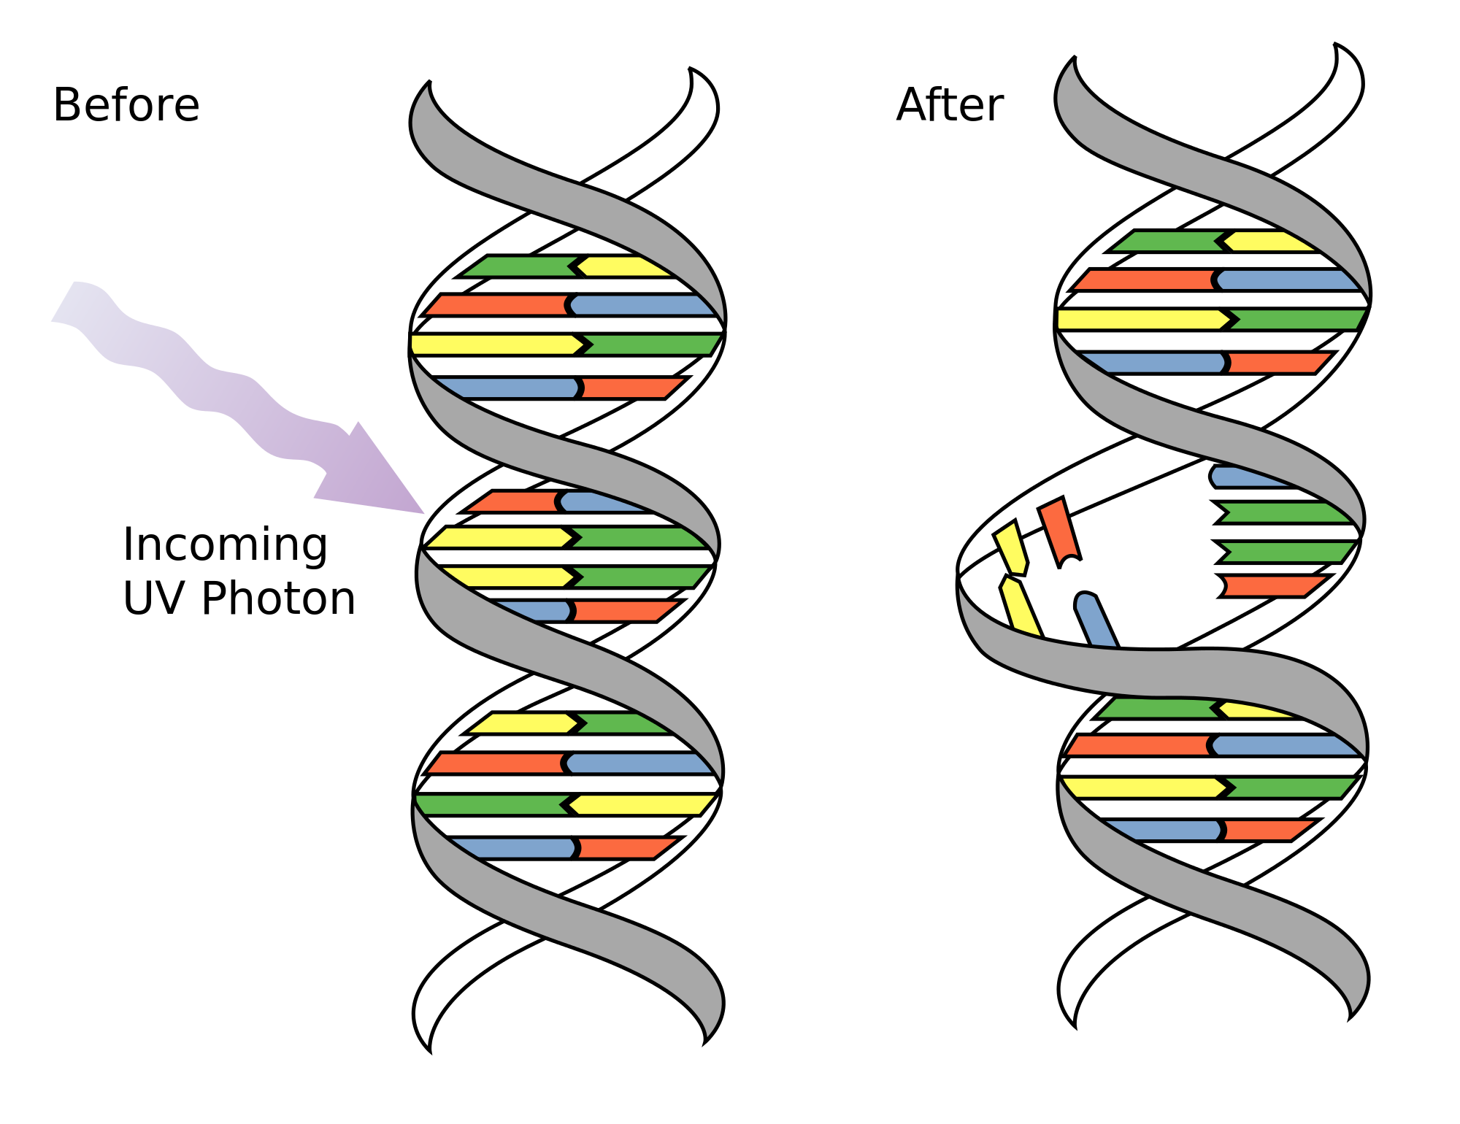
Need to add a line
UV Light
DNA Mutation
Causes
Reduces
A skin pigment called melanin

Slide 10
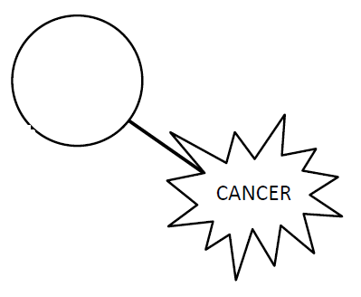
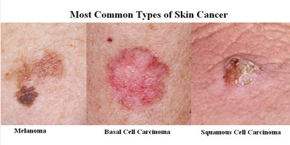
DNA Mutation
can lead to...

