Slide 1
29 November 2012
AGENDA:
DO NOW: read page 27 in your student guide
BILL questions 1-3
Complete quick reference sheet, page 27
Estimating size of microscopic samples
BILL questions 4-5
Begin viewing cells lab

Slide 2
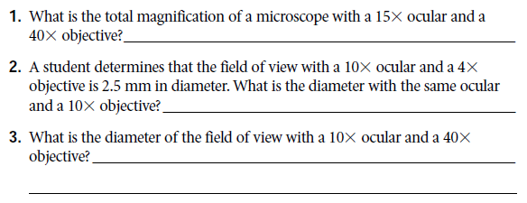
BILL Questions show your working
(Assuming same microscope)

Slide 3
BILL Questions show your working
600X
1 mm or 1000um
(Assuming same microscope)
0.25 mm or 250um

Slide 4
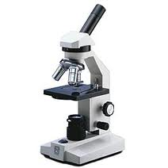
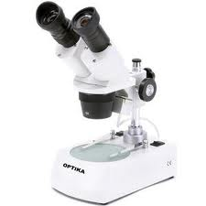
Use the microscopes to complete the quick reference sheet, page 27
You have 15 minutes.
No more than 2 people per microscope.
Be sure to use the compound microscope, not the dissecting microscope.
Record measurements to the 10th of a mm.

Slide 5
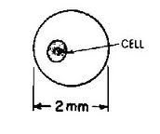
Estimating Size of Objects in a Microscope
Determine the size of the FOV. You just did this.
Estimate what proportion of the FOV your sample takes up. ½ or ¼ or 1/8 or 1/100th?
Multiply your estimated proportion by the FOV size.
¼ X 2.0 mm = 0.5 mm
Round your answer to the same precision as your FOV measurement (tenths).
2.0 mm

Slide 6
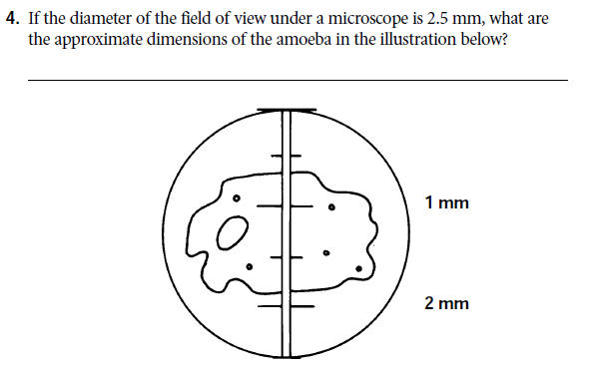
BILL Questions show your working

Slide 7
BILL Questions show your working
HEIGHT
FOV: 2.5 mm
Estimate: ½
Multiply: (1/2)(2.5)=1.25
Round = 1.3mm
LENGTH
FOV: 2.5 mm
Estimate: 3/4
Multiply: (3/4)(2.5)=1.875
Round = 1.9 mm

Slide 8
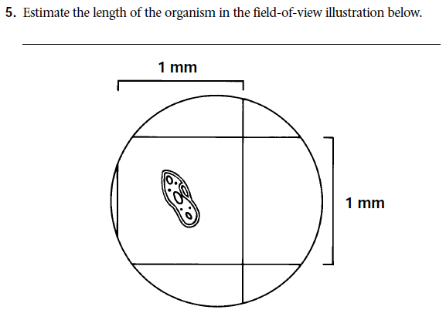
BILL Questions show your working
∧height and

Slide 9
BILL Questions show your working
∧height and
HEIGHT
FOV: 1.5 mm
Estimate: 1/3
Multiply: (1/3)(1.5)=0.5
Round = 0.5 mm
LENGTH
FOV: 1.5 mm
Estimate: 1/9
Multiply: (1/9)(1.5)=0.1666
Round = 0.2 mm

Slide 10
Viewing Cells Lab
Read the rules for lab drawing in your guide, page 28.
Observe four cell types: potato, elodea, cheek, onion root.
Microscopes are already set up, with slides in place.
DO NOT REMOVE SLIDES.
You CAN change objective lenses and focus.
Draw four cells, each on their own ½ sheet of unlined, white paper
Draw single cells, not everything in the FOV
Do not draw the FOV circle
Be sure you:
Estimate size of cell. Don’t worry about linear magnification, yet.
Draw what you see, not what you expect to see.
Label in a vertical list

