Slide 1
CHAPTER 4 ENVIRONMENTAL ECONOMICS AND CONSUMPTION WALL TO WALL, CRADLE TO CRADLE A leading carpet company takes a chance on going green

Slide 2
CHAPTER 4 ENVIRONMENTAL ECONOMICS AND CONSUMPTION WALL TO WALL, CRADLE TO CRADLE A leading carpet company takes a chance on going green
Answer the questions on the first page of your notes
Have students watch the beginning of Wall-E.
https://www.youtube.com/watch?v=nLx_7wEmwms
Which system does Wall E represent?

Slide 3
WALL TO WALL, CRADLE TO CRADLE
A leading carpet company takes a chance on going green
At the end of this unit you will know:
How the ecological footprint relates to the use of natural capital and interest
How we can use factors influencing our actions to reduce environmental impact
Differences between costs and benefits of conventional economics and environmentally based economics.
Learning Outcomes

Slide 4
WALL TO WALL, CRADLE TO CRADLE
A leading carpet company takes a chance on going green
Consideration of our ecological footprint allows us to measure our impact on Earth based on resource use. EF varies country by country and by individual depending on lifestyle choices such as food production, size of house, and material consumption choices.
Main Concept #1

Slide 5
WALL TO WALL, CRADLE TO CRADLE
A leading carpet company takes a chance on going green
More considerate consumption choices need to include aspects of economics and social costs as well as environmental costs. If this is not taken into account then a society could exceed its carrying capacity and a population crash could occur.
Main Concept #2

Slide 6
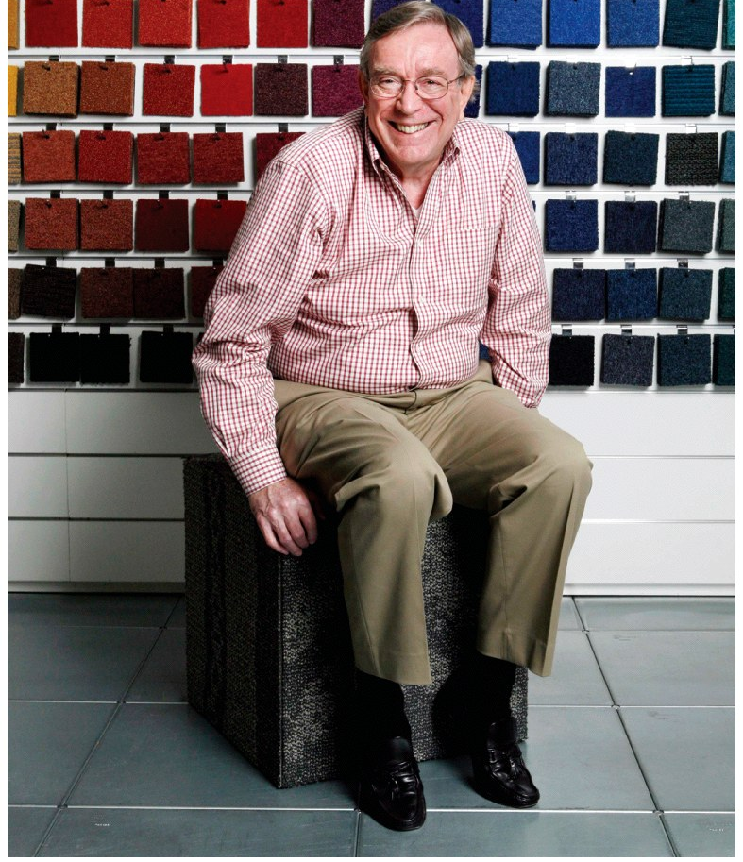
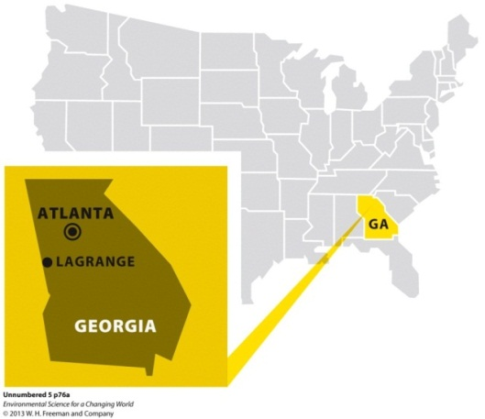
4
WALL TO WALL, CRADLE TO CRADLE
A leading carpet company takes a chance on going green
Case Study: Interface Carpet
World’s leading seller of replaceable carpet tiles
Problem: Carpet manufacturing from petroleum is toxic and releases large quantities of air and water pollutants. It is also a non-sustainable, resource intensive product.
Action: Looked to nature as an economic model and initiated new processes and material use. Initiated a “take back and recycle” program at the end of the product’s life.
Established a “lease” program to enjoy the services of carpet without actually buying the carpet.
TERMS TO KNOW:
Sustainable
Economics
Ecosystem services

Slide 7
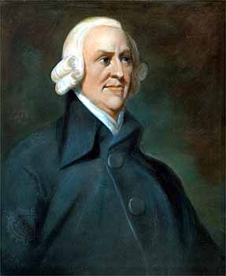
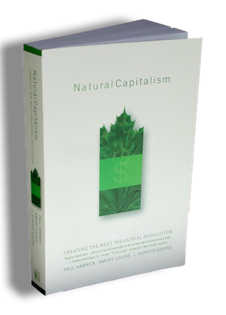
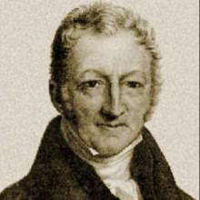
Natural Capitalism vs. Classical Capitalism
“Natural Capitalism” is a book that has lead the environmental economics movement.
Natural Capitalism is based off of the idea of sustainability and renewability. Natural resources have value and can be depleted.
How does the carpet company follow this model of economics?
Classical Capitalism assumes that natural capital is infinite and is based on supply and demand.
Which companies follow this model of economics?
Adam Smith
Thomas Malthus

Slide 8
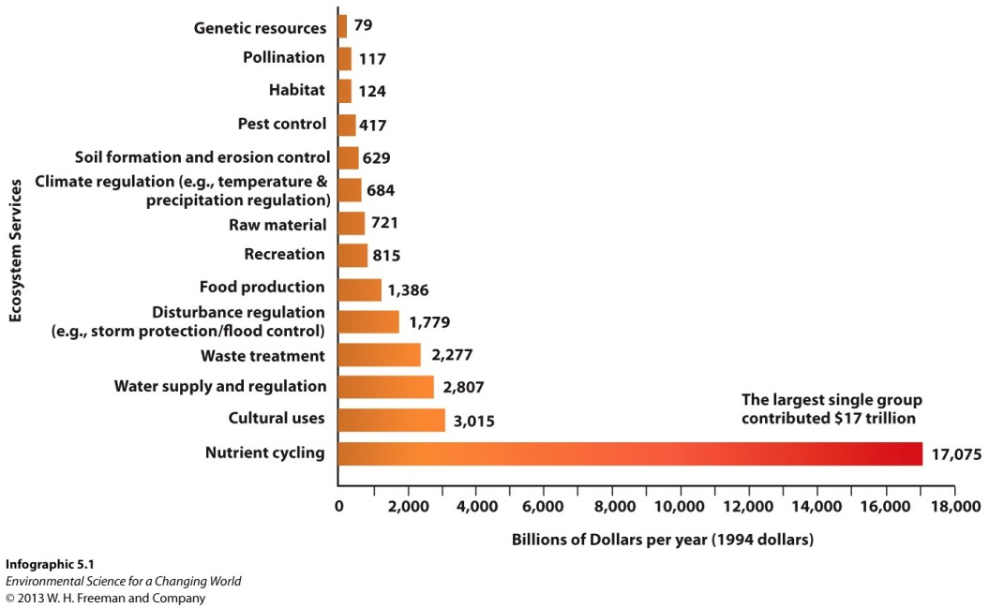
WALL TO WALL, CRADLE TO CRADLE
A leading carpet company takes a chance on going green
Choices made by businesses and consumers impact the environment—energy, water, waste.
Environmentally mindful businesses look to nature as a model.
Ecosystems goods and services—timber fish, and water are goods; air purification, erosion control, and nutrient cycling are services.
Some services, such as oxygen production are life supporting.

Slide 9
WALL TO WALL, CRADLE TO CRADLE
A leading carpet company takes a chance on going green
Value of ecosystem goods and services
Choices made by businesses and consumers impact the environment—energy, water, waste.
Environmentally mindful businesses look to nature as a model.
Ecosystems goods and services—timber, fish, and water are goods; air purification, erosion control, and nutrient cycling are services.
Most services, such as oxygen production, are life supporting

Slide 10
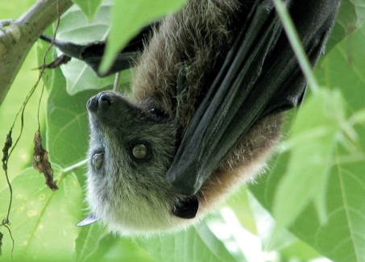
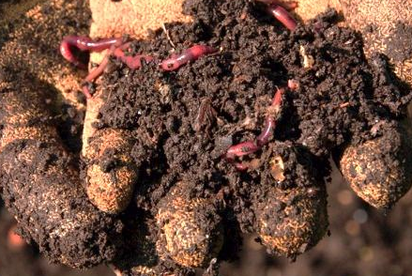
WALL TO WALL, CRADLE TO CRADLE
A leading carpet company takes a chance on going green
Answer the questions on your notes about the values of ecosystem services and goods.
Value of ecosystem goods and services

Slide 11
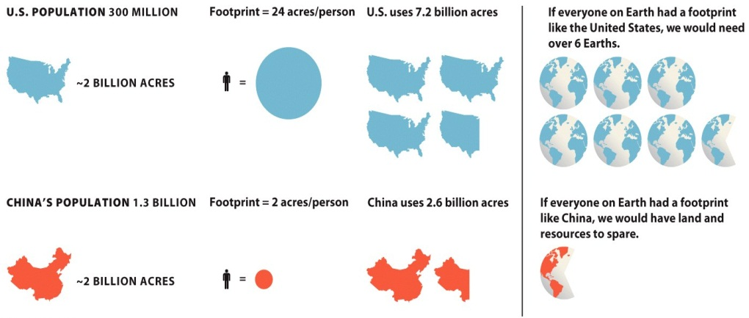
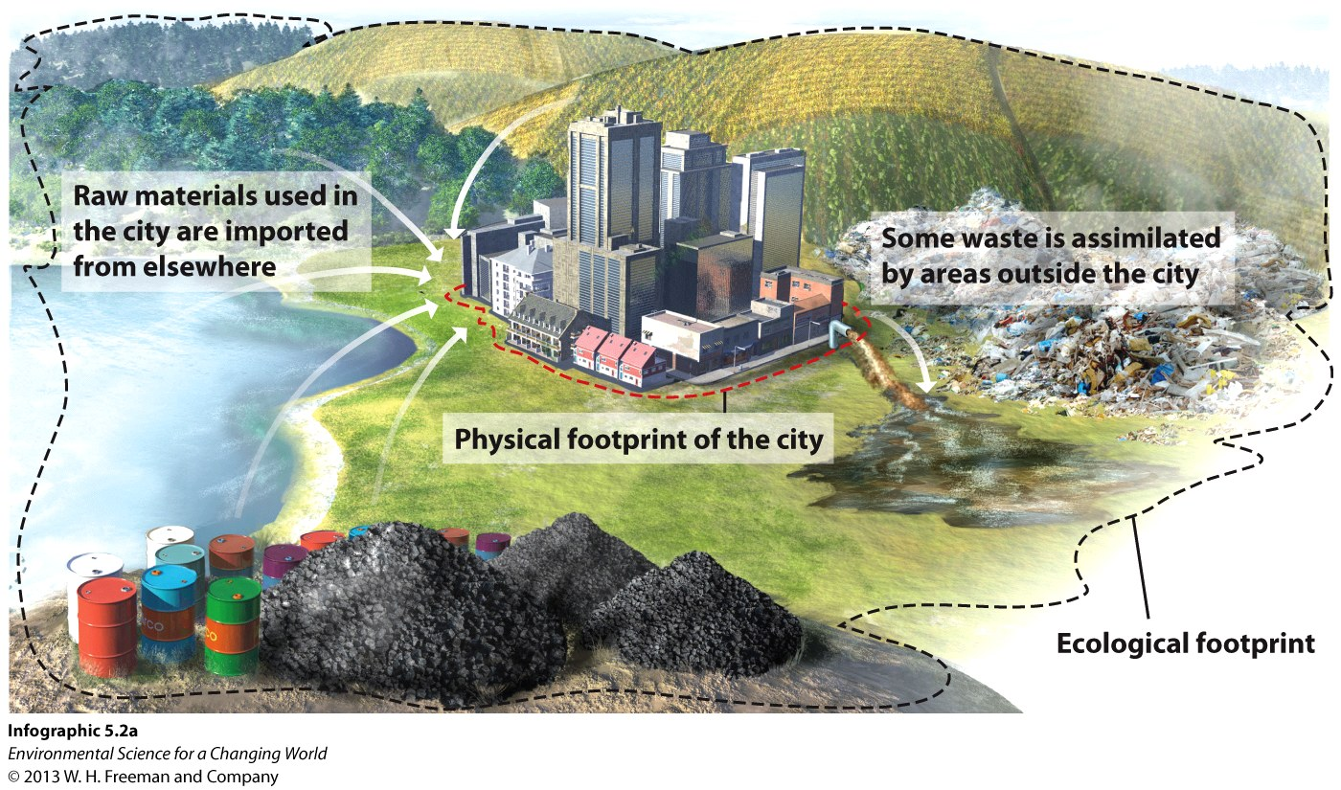
Businesses and individuals impact the environment with their economic decisions
Ecological footprint – Land needed to provide resources and to assimilate waste
An intact ecosystem is naturally sustainable. Degradation of the system prevents nature from providing goods and services–a threat to our future economically, socially, and environmentally.
TERMS TO KNOW:
Ecological footprint
Natural capital
Natural income

Slide 12
Businesses and individuals impact the environment with their economic decisions
Ecological footprint – Land needed to provide resources and to assimilate waste
An intact ecosystem is naturally sustainable – degradation of the system prevents nature from providing goods and services - threat to our future economically, socially, and environmentally.
TERMS TO KNOW:
Ecological footprint
Natural capital
Natural income

Slide 13
Businesses and individuals impact the environment with their economic decisions
Ecological footprint – Land needed to provide resources and to assimilate waste
An intact ecosystem is naturally sustainable. Degradation of the system prevents nature from providing goods and services—a threat to our future economically, socially, and environmentally.
TERMS TO KNOW:
Ecological footprint
Natural capital
Natural income

Slide 14
Businesses and individuals impact the environment with their economic decisions
Ecological footprint – Land needed to provide resources and to assimilate waste
An intact ecosystem is naturally sustainable – degradation of the system prevents nature from providing goods and services - threat to our future economically, socially, and environmentally.
TERMS TO KNOW:
Ecological footprint
Natural capital
Natural income

Slide 15
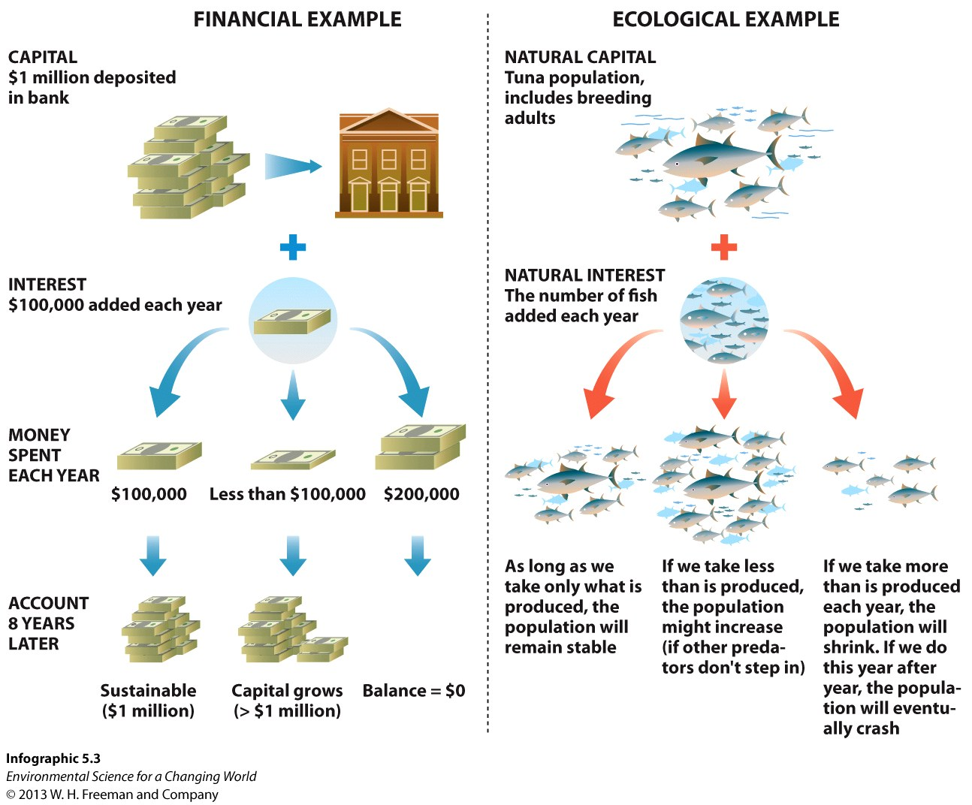
Businesses and individuals impact the environment with their economic decisions
TERMS TO KNOW:
Ecological footprint
Natural capital
Natural income
Natural capital – Consumable resources like air, water, trees, fish, and the systems that produce them. If they are harvested sustainably they can be used forever.

Slide 16
Businesses and individuals impact the environment with their economic decisions
Natural capital – Consumable, renewable resources like air, water, trees, fish, and the systems that produce them. If harvested correctly, they can be used forever—AKA sustainable
Natural income (interest) (sustainable yield)– What is produced by the capital over time—more trees, fish, and oxygen--How much of the interest could we “spend” without depleting capital?
Which 2 fish options are sustainable?

Slide 17
Businesses and individuals impact the environment with their economic decisions
TERMS TO KNOW:
Ecological footprint
Natural capital
Natural income
Financial Economic Example:
Deposits or investments earn additional money.
Spending no more than the interest allows the capital to continue making money.
Spending the interest and any portion of the capital will deplete both the source and the benefits.

Slide 18
Businesses and individuals impact the environment with their economic decisions
TERMS TO KNOW:
Ecological footprint
Natural capital
Natural income
Ecological Economic Example:
Natural capital produces additional product (income).
Consuming no more than the interest allows the natural capital to continue making more product.
Consuming the income and any portion of the capital will deplete both the source and the benefits.

Slide 19
Businesses and individuals impact the environment with their economic decisions
Case Study: Interface Carpet
Using the financial and ecological examples, Interface set a goal to put back more resources than consumed.
“Restorative enterprise”
Reduced energy usage from fossil fuels by 55%
Reduced total energy usage by 43%
Maximized energy efficiency with skylights, solar tubes, energy trackers, better heating and air systems

Slide 20
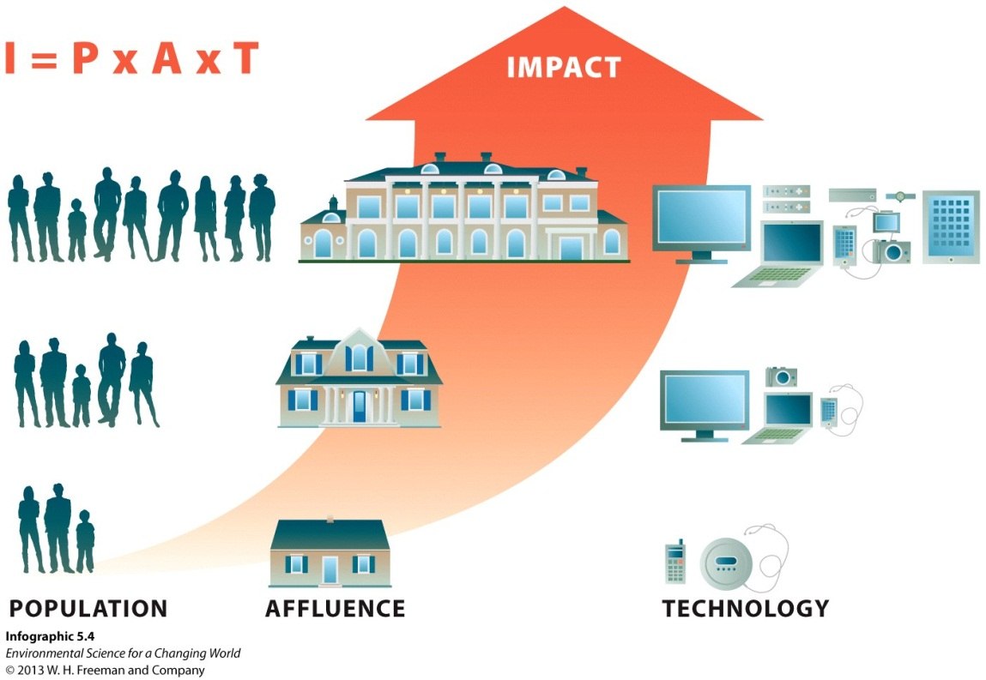
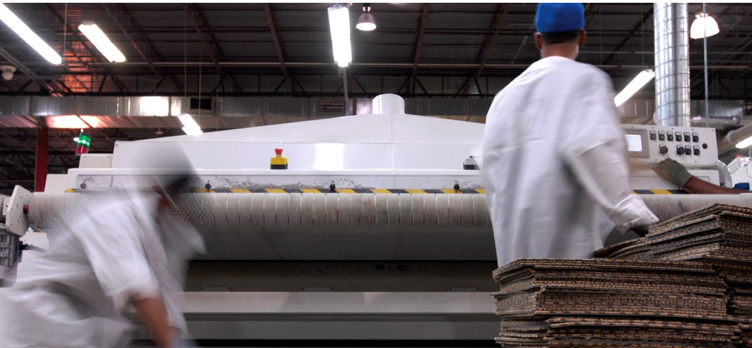
Businesses and individuals impact the environment with their economic decisions
TERMS TO KNOW:
IPAT model
The IPAT model used to estimate an ecological footprint for a population.
It is based on size of the population, level of affluence, and impact of technology.
Affluent and technology-dependent populations use more resources and generate more waste.
Note that technology can also have a beneficial effect when it increases efficiency.

Slide 21
Businesses and individuals impact the environment with their economic decisions
TERMS TO KNOW:
IPAT model
The IPAT model used to estimate an ecological footprint for a population.
Case Study: Interface Carpet
Using technology in a beneficial way, Interface developed new adhesives from recycled soda bottles.
No VOCs, easier replacement of damaged tiles
Reduced health risks, waste, and footprint
I = (P x A)/T

Slide 22
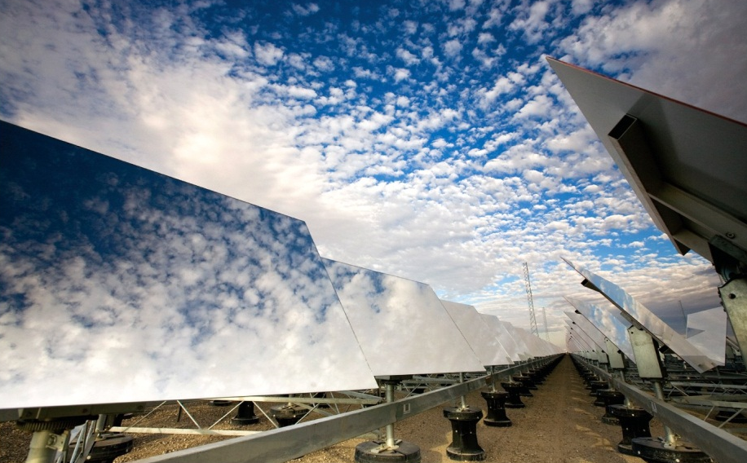
Businesses and individuals impact the environment with their economic decisions

Slide 23
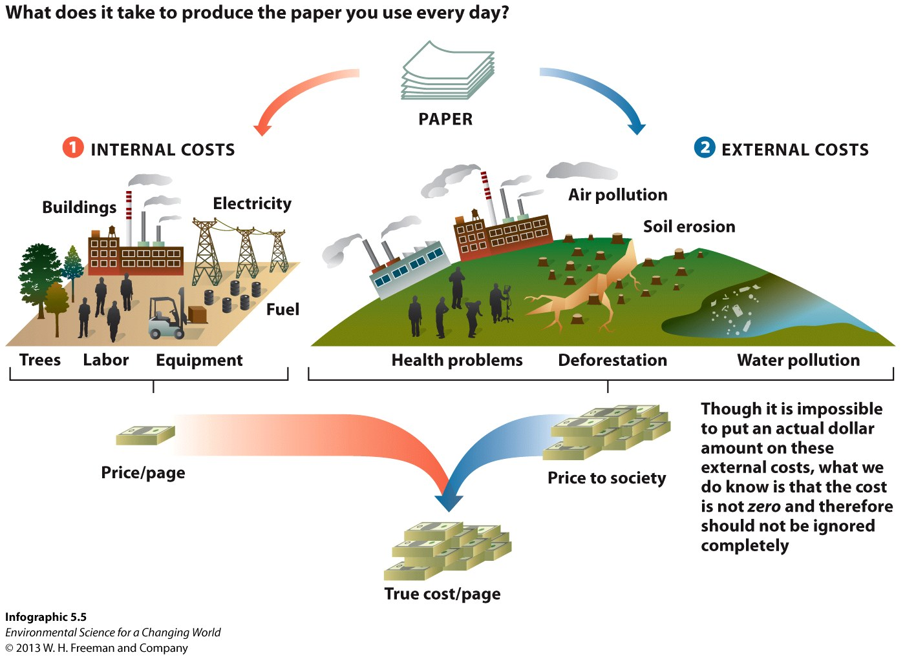
Mainstream economics supports some actions that are not sustainable
Mainstream economics does not account for all potential costs—costs associated with environmental stress during resource extraction, clean-up costs for waste from production, healthcare costs from toxic exposure, etc
TERMS TO KNOW:
Internal cost
External cost
Triple-bottom line
True cost

Slide 24
Mainstream economics supports some actions that are not sustainable
Mainstream economics does not account for all potential costs – Costs associated with environmental stress during resource extraction, clean-up costs for waste from production, healthcare costs from toxic exposure, etc.
TERMS TO KNOW:
Internal cost
External cost
Triple-bottom line
True cost
Internal costs are included when the product is priced.

Slide 25
Mainstream economics supports some actions that are not sustainable
Mainstream economics does not account for all potential costs—costs associated with environmental stress during resource extraction, clean-up costs for waste from production, healthcare costs from toxic exposure, etc.
TERMS TO KNOW:
Internal cost
External cost
Triple-bottom line
True cost
External costs are paid by the public at large from degraded health, ecosystems, or opportunities.

Slide 26
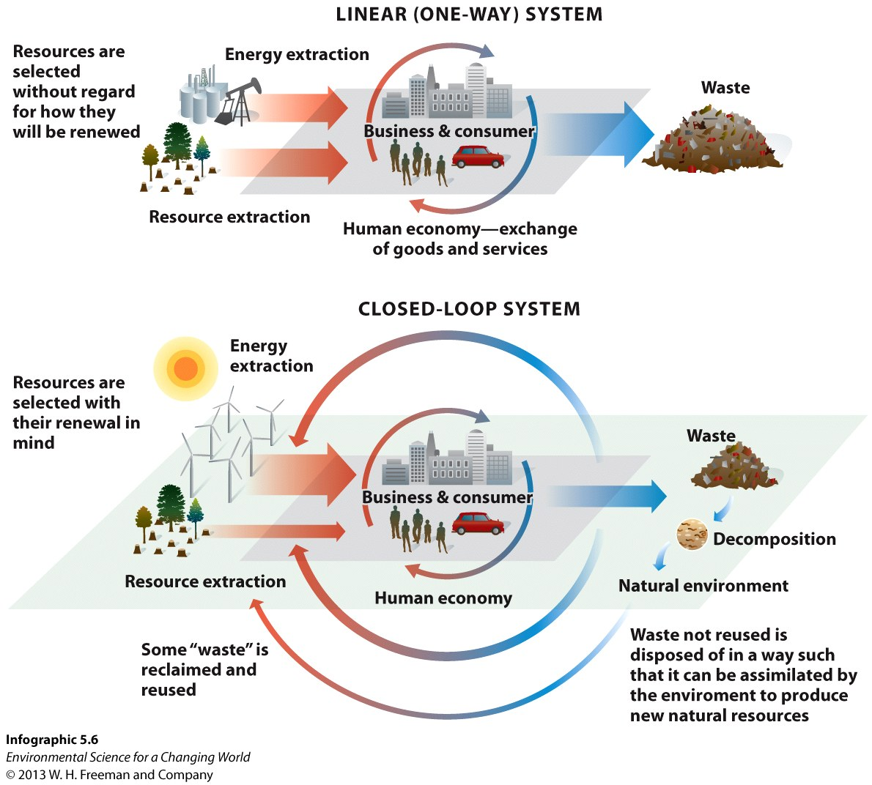
Mainstream economics supports some actions that are not sustainable
Linear production models assume that natural and human resources are infinite. We can either always get more or substitute for something else.
Closed-loop systems consider the life of a product, including its disposal throughout the production process.

Slide 27
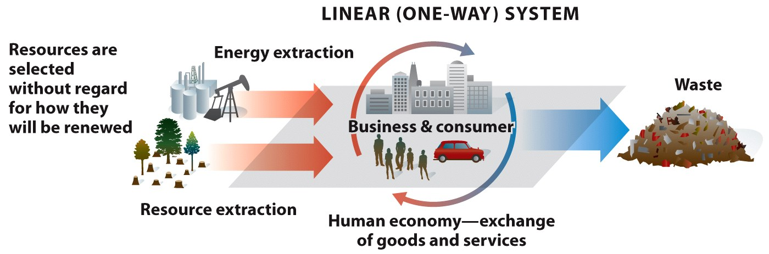
Mainstream economics supports some actions that are not sustainable
Linear production models assume that natural and human resources are infinite. We can either always get more or substitute for something else.

Slide 28
Mainstream economics supports some actions that are not sustainable
Closed-loop systems consider the life of a product, including its disposal throughout the production process.

Slide 29
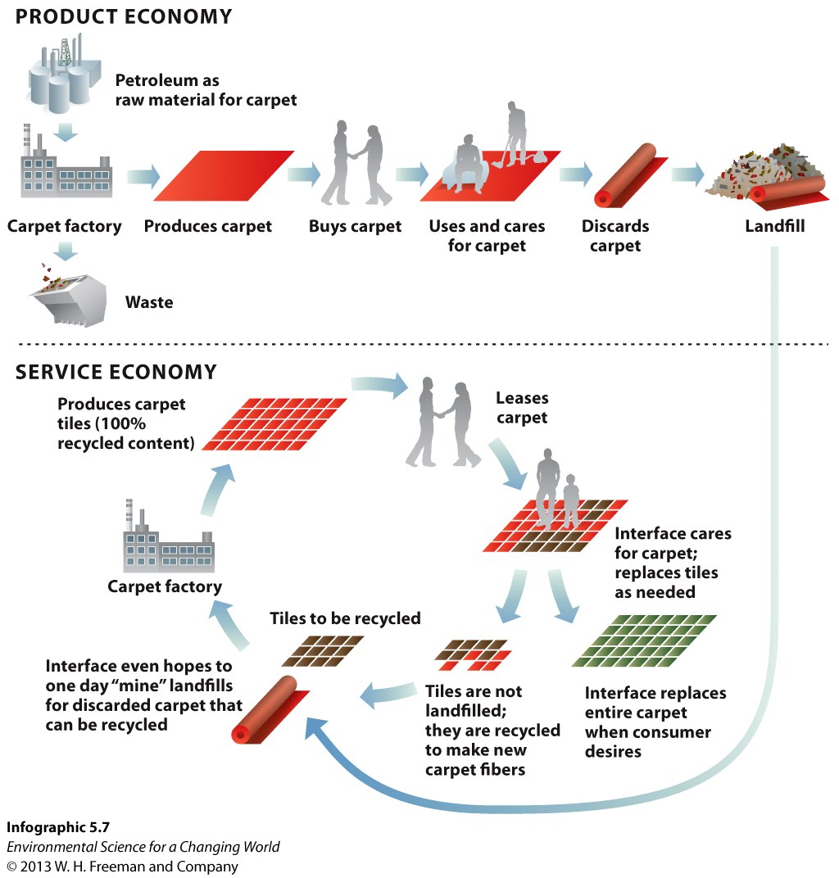
Businesses can learn a great deal about how to be sustainable from nature
A service economy that focuses on providing the consumer the service desired, rather than product, decreases resource drain and lessens waste while still potentially providing a profit for the seller.

Slide 30
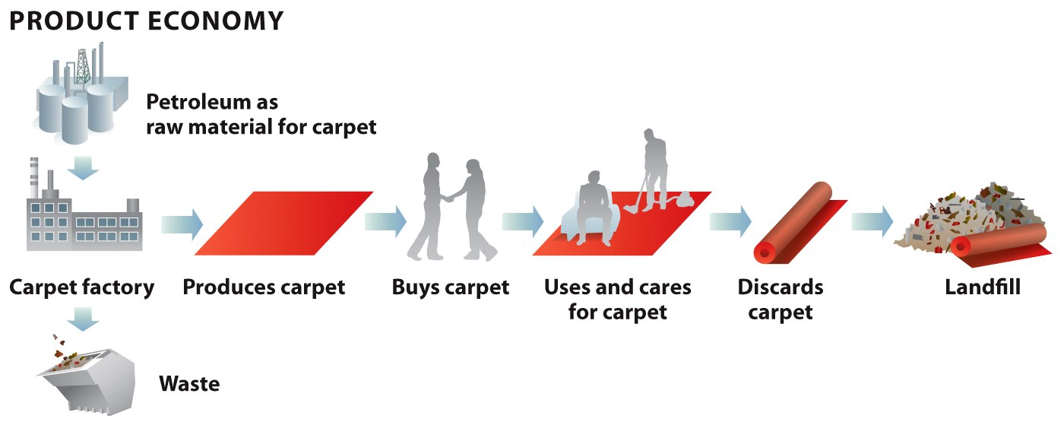
Businesses can learn a great deal about how to be sustainable from nature
Linear, product-based economy – generally unsustainable

Slide 31
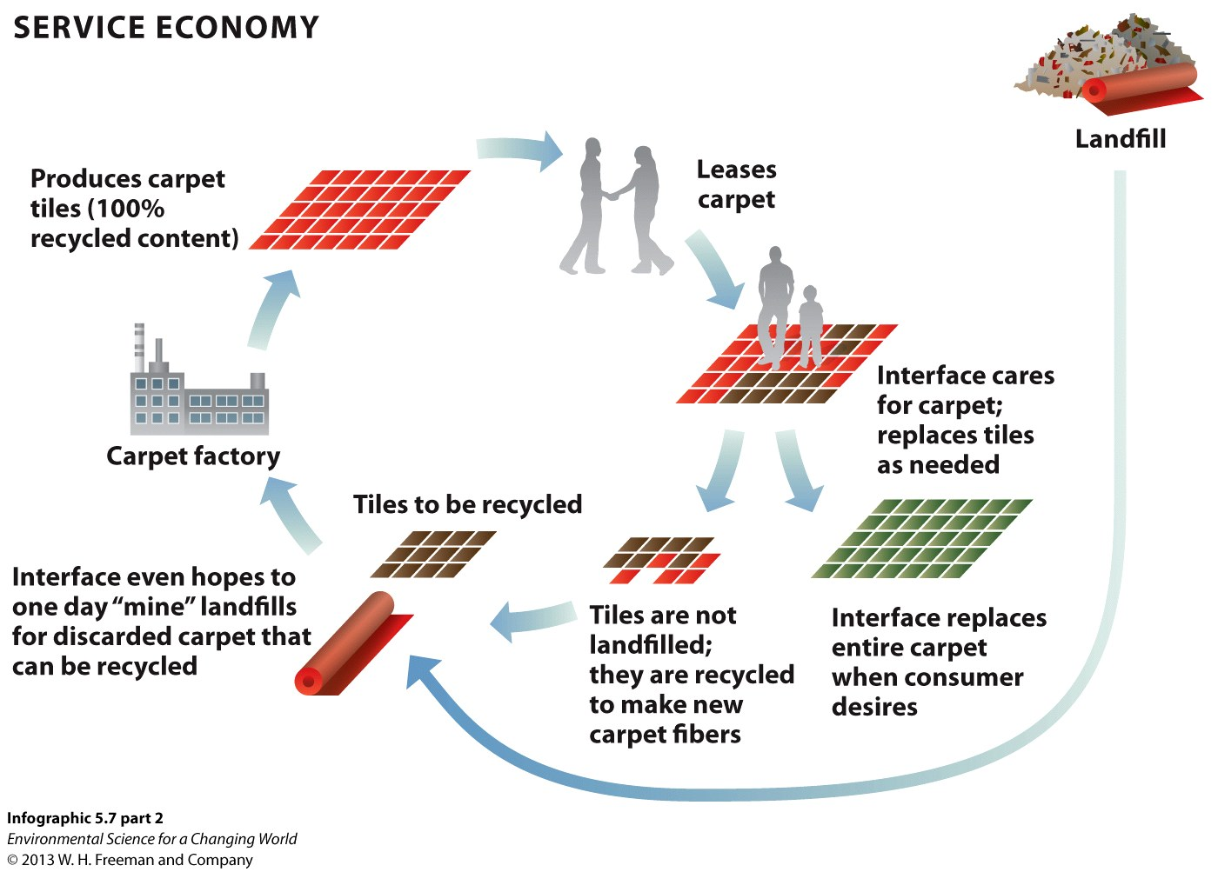
Businesses can learn a great deal about how to be sustainable from nature
Cyclical service economy – low waste and high sustainability

Slide 32
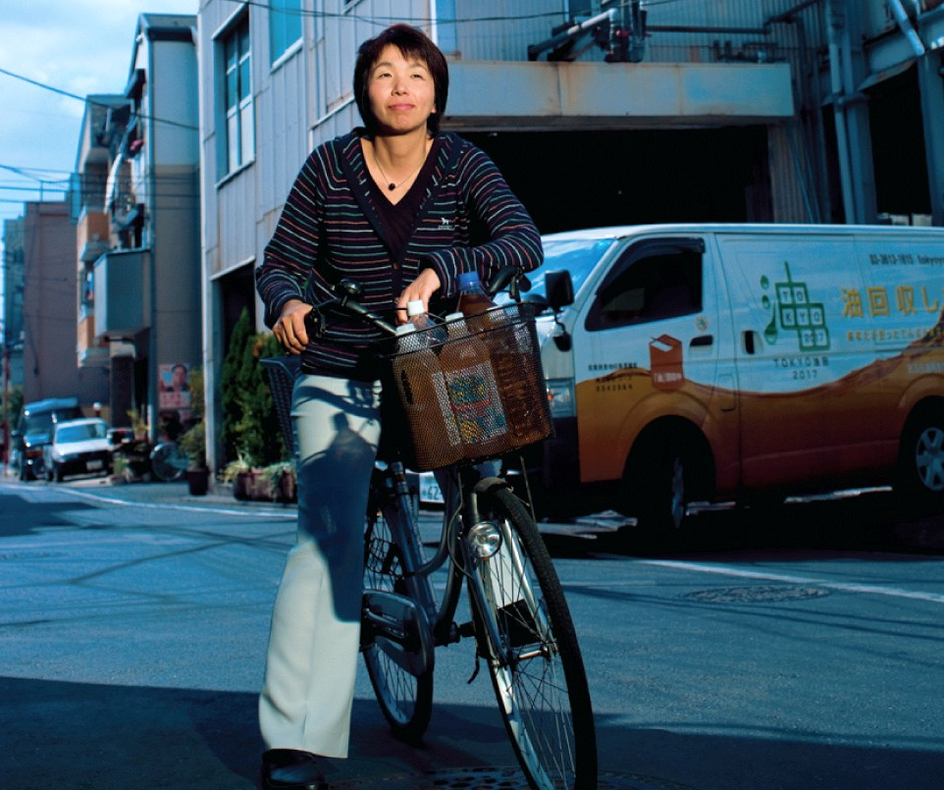
Businesses can learn a great deal about how to be sustainable from nature
Example of new ideas in business
A Japanese company, “U Corporation,” collects used cooking oil from over 5000 Tokyo restaurants for conversion into biodiesel to fuel city buses.
Yumi Someya – Head of U Corporation in Tokyo

Slide 33
There are tactics for achieving sustainability
Moving toward sustainability can present some real challenges for businesses.
Upgrade costs
Lack of funding for improvements
Competitive disadvantage based on cost recovery
Consumers will have to put their buying power behind their environmental ideals.
Governments can shift incentive dollars to encourage sustainability.

Slide 35
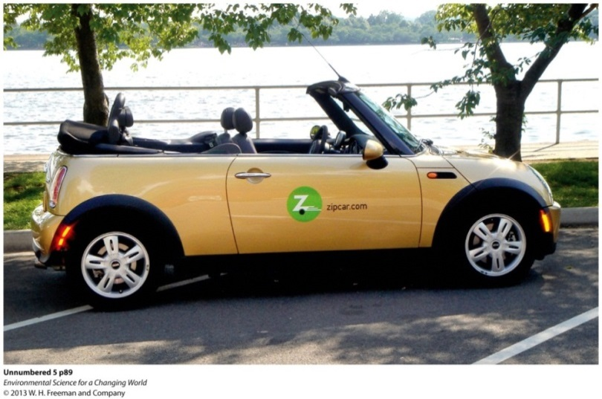
What can you do?
You hold power through your money. What you buy supports that company so choose companies that are both environmentally and socially friendly.
Reduse, Reuse, Refuse!!!
Choose to buy fewer more expensive things. Higher quality means it will last longer.
Ride mass transit or sign up
for a car share program like
Zip Car.

Slide 36
Homework—due tomorrow
Look up 10 environmentally conscience/sustainable businesses and complete the following table
Business Name | Specifically what they do to be more environmental

Slide 37
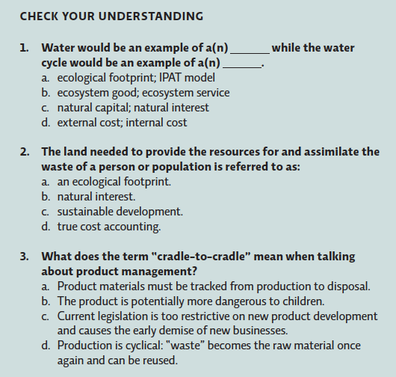
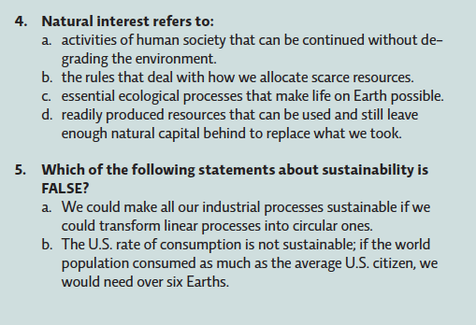
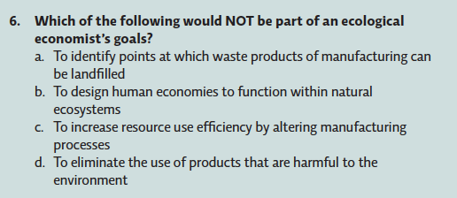
4
UNDERSTANDING THE ISSUE

Slide 38
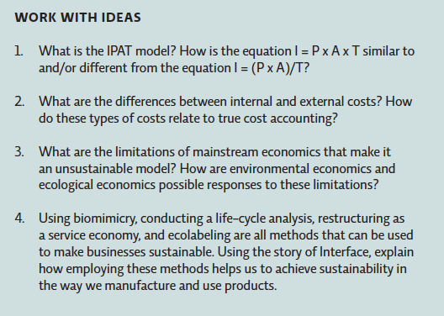
4
UNDERSTANDING THE ISSUE

Slide 39
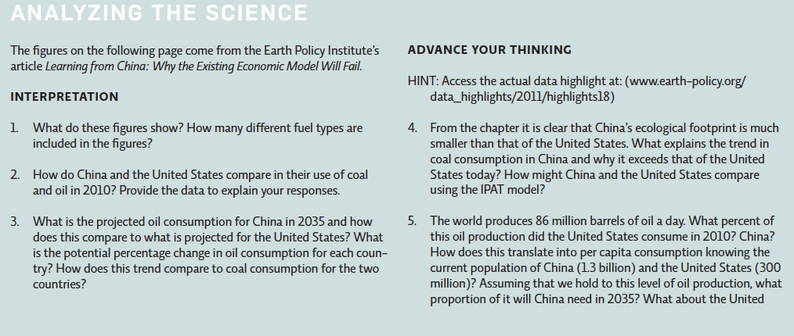
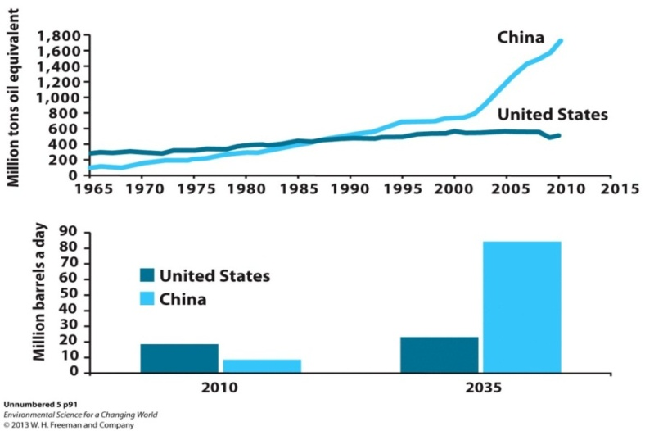
4
ANALYZING THE SCIENCE

Slide 40
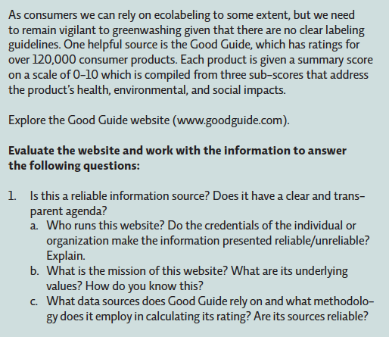
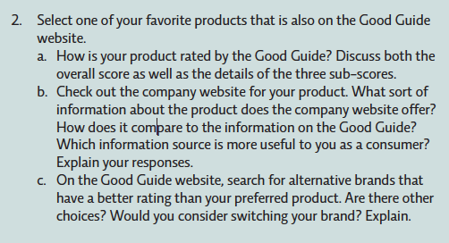
4
EVALUATING NEW INFORMATION
www.goodguide.com

Slide 41
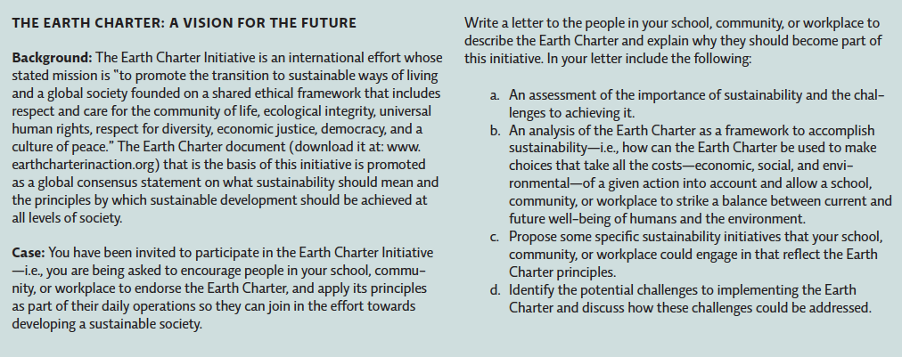
4
MAKING CONNECTIONS
“To promote the transition to sustainable ways of living and a global society founded on a shared ethical framework that includes respect and care for the community of life, ecological integrity, universal human rights, respect for diversity, economic justice, democracy, and a culture of peace.”

