Slide 1
Introduction to Environmental Systems
The Nature of Environmental Value Systems

Slide 2
Stop here and have students take the survey on the computers.
EVS Survey

Slide 3
I wish to speak a word for Nature, for absolute freedom and wildness, as contrasted with a freedom and culture merely civil…to regard man as an inhabitant, or a part and parcel of Nature, rather than a member of society.
–Henry David Thoreau

Slide 4
The Nature of Environmental Science
Environmental systems is an interdisciplinary field that includes both scientific and social aspects of human impact on the world.

Slide 5
Environmental Value System
Conflicting values
Examples:
Undeveloped rivers are wasteful because the potential energy it contains vs. keeping the river natural provides a pristine habitat for living things.
Old growth forests = $$$ vs. all living things that make up the forest have a kind of value beyond their economic value

Slide 6
Environmental Value System
An environmental value system is a particular world view that shapes the way an individual or group of people perceive and evaluate environmental issues.
Influenced by:
Get in a group and discuss what you think influences how people view the environment.
Culture (including religion)
Economy
Socio-political context (eg. Republican vs. Democrat)

Slide 7
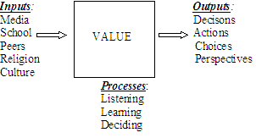
Environmental Value System
An environmental value system has inputs and outputs.
Complete the diagram on your notes to include examples of inputs, outputs, and processes.

Slide 8
Environmental Value System
3 Philosophical Approaches
Anthropocentrism
Ecocentrism
Technocentrism

Slide 9
Environmental Value System Anthropocentrism
An anthropocentric viewpoint argues
that humans must sustainably manage the global system.
through the use of taxes, environmental regulation and legislation.
Debate would be encouraged to reach a consensual, pragmatic approach to solving environmental problems.
Humans are not dependent on nature but nature is there to benefit humankind.

Slide 10
Anthropocentric
Economic growth is the goal
We can always keep the economy growing.
There will always be more resources to exploit.

Slide 11
Environmental Value System Ecocentrism
An ecocentric viewpoint integrates social, spiritual and environmental dimensions into a holistic ideal.
It puts ecology and nature as central to humanity and emphasizes a less materialistic approach to life with greater self-sufficiency of societies.
An ecocentric viewpoint prioritizes biorights, emphasizes the importance of education and encourages self-restraint in human behavior.

Slide 12
The Gaia Hypothesis—the idea that the planet is a living organism is a deep ecologists viewpoint

Slide 13
Environmental Value System Technocentrism
In addition to the two philosophical approaches discussed earlier, a new approach has recently emerged.
Technocentrics have absolute faith in technology and industry to solve environmental problems
They firmly believe that humans have control over nature.

Slide 14
Technocentrism
We can solve any pollution problem that we cause
Whatever we do, we can solve it.

Slide 15
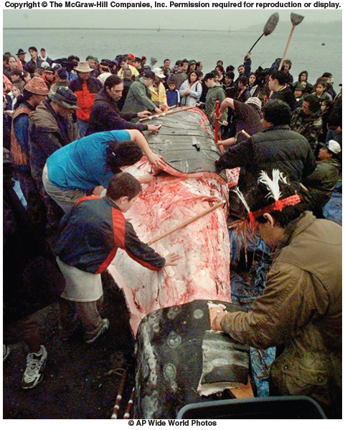
The Gray Whales of Neah Bay (Enger pg. 18)
Clash of different value systems about exploitation of natural resources.

Slide 16
Cars and Value Systems
Let’s use cars as an example
Air pollution due to cars | EVS?
Gas Tax
Electric Car
Walk instead

Slide 17
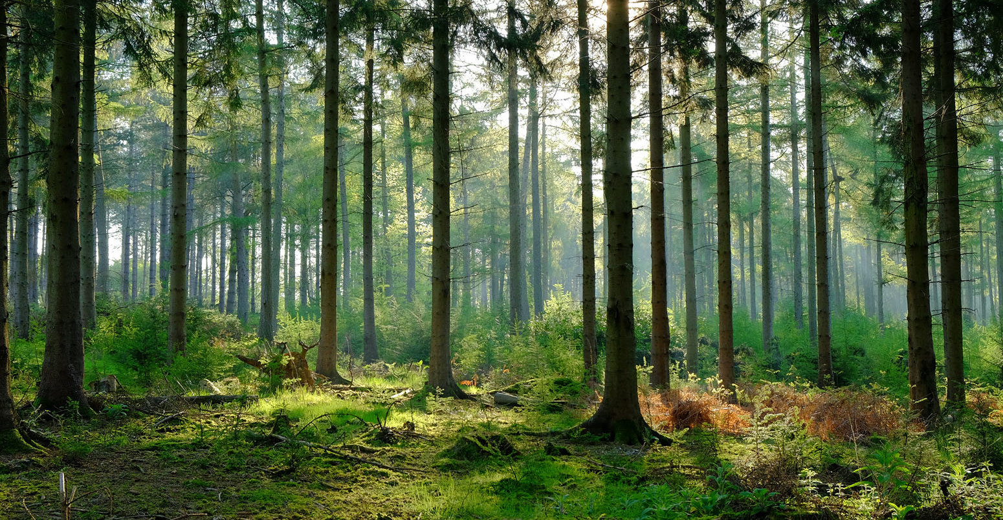
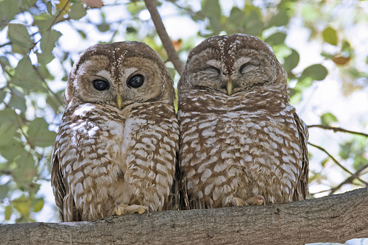
Environmental Value Systems
Each approach values different parts of the environment differently.
Eg. An anthropocentric might look at a forest as timber while an ecocentric would look at it as beauty and a place for organisms to live

Slide 18
Environmental Value Systems
As a class, let’s compare the environmental value system of the following two societies:
First Nation American vs. European pioneers (make a chart)

Slide 19
Environmental Value System Personal
Personally you should reflect upon where you stand on the continuum of environmental philosophies throughout this course.

Slide 20
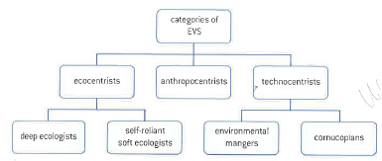
Conceptual Diagram of Range of EVSs.

Slide 21
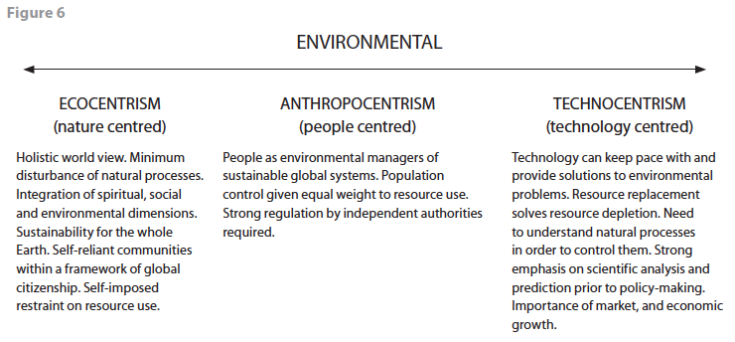
Environmental Value Systems Spectrum
There is a spectrum of viewpoints and a person may be extreme ecocentric on one topic but more middle of the line on another. It all depends on the inputs a person receives during her/his lifetime

Slide 22
Corporate Environmental Value System
Corporations are legal entities designed to operate at a profit.
They possess certain rights and privileges but are “artificial persons”.
Primary purpose is neither to benefit the public nor to protect the environment but to generate a financial return for its shareholders.

Slide 23
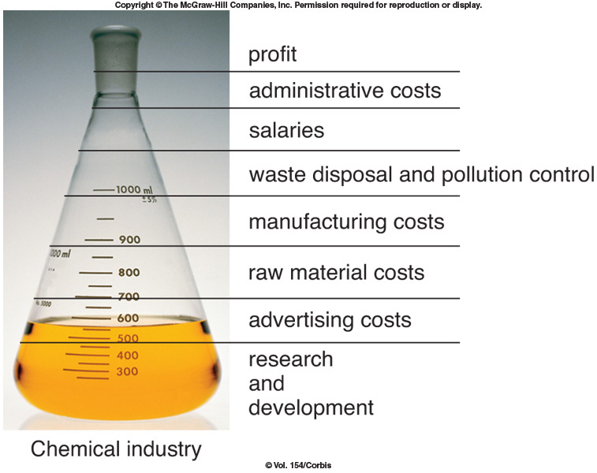
Corporate Decision Making
When corporations look at pollution control and waste disposal they view its cost like any other cost and reductions in cost increase profits

Slide 24
Corporate Environmental Value System Profitability and Power
Many important decisions affecting the environment are made not by governments or the public, but by executives of corporations.
More profit → more expansion → increase in productivity → more power → more decision making → more profit
WTO (World Trade Organization)

Slide 25
Corporate Environmental Value System
Corporations are owned and therefore driven by shareholders.
If shareholders demand environmental responsibility, then corporations must comply.
What can you do?
Invest in environmentally ethical corporations
Homework: use the Internet to research 10 environmentally ethical corporations—make a list of their names, what they sell (eg. General Electric (home appliances), Interface Incorporated (carpets)), and what they do to be environmentally ethical.

Slide 26
Corporation name | What they sell | How are they environmentally responsible?

