Slide 1
Feedback Loops

Slide 2
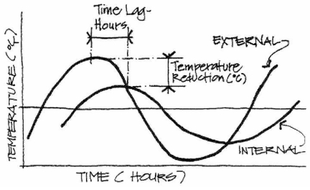
Feedback Loops
A feedback loop is when a system’s output can serve as an input to that same system. It is a circular process.
Feedback loops involve time lags.

Slide 3
Feedback Loops
There are 2 kinds of feedback loops
1. Positive feedback loops
2. Negative feedback loops

Slide 4
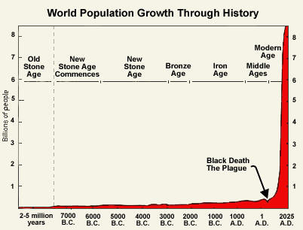
Positive Feedback Loops
1. Positive feedback loop
Uses the output from a process to increase that process
Eg. Exponential growth of the human population

Slide 5
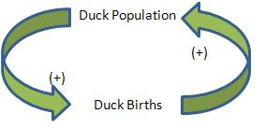
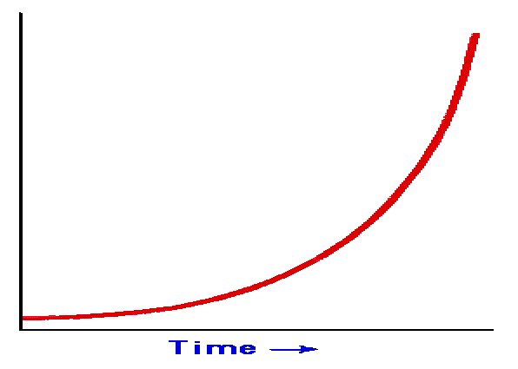
Positive Feedback Illustrations
Positive Feedback graph
Positive Feedback Loop

Slide 6
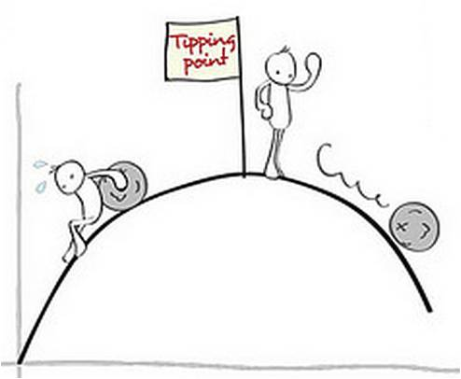
Positive Feedback Loops
Positive feedback loops are destabilizing.
Drives the system toward a tipping point where a new equilibrium is adopted.

Slide 7
Positive Feedback Loops
Example of tipping point
Coral reef death
If ocean acidity levels rise enough , the reef coral dies and cannot regenerate

Slide 8
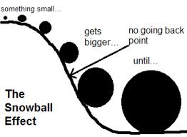
Positive Feedback Loop
Each plus involves another plus; there is a snowball effect.
A positive feedback loop left to itself can lead only to the destruction of the system
The wild behavior of positive loops - a veritable death wish - must be controlled by negative loops

Slide 9
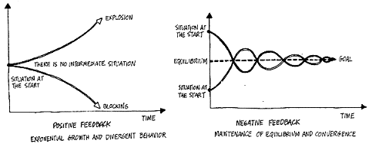
Negative Feedback Loops
2. Negative Feedback Loops
Reverses the direction in which a system is moving.
It is a self regulating method of control leading to maintenance of a steady state equilibrium
Eg. Predator-prey relationship

Slide 10
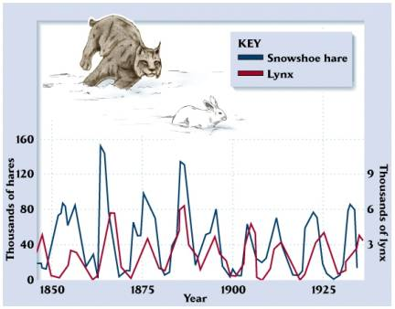
Negative Feedback Loop
Eg.
The hare and the lynx oscillate with lag times between highs and lows.

Slide 11
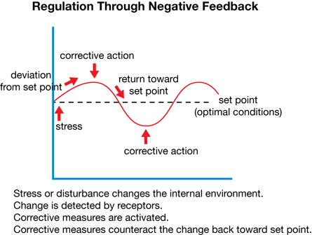
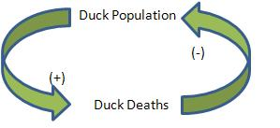
Negative Feedback Illustrations
Negative Feedback Graph
Negative Feedback Loop

Slide 12
Homeostasis
Homeostasis is when the system is in dynamic equilibrium.
Regulatory processes balance each other and internal conditions are stable. This is the goal of negative feedback loops.

Slide 13
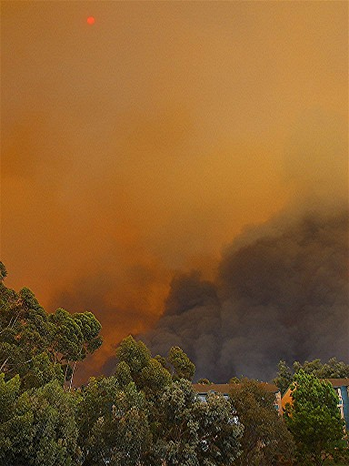
Disturbances
Disturbances—periodic, destructive events such as fires and floods are a normal part of natural systems.
The resilience of a system, ecological or social, refers to its tendency to avoid such tipping points and maintain stability

