Slide 1
Social Factors of Human Population Growth

Slide 2
Indicators of Population Growth
Several factors contribute to population growth
Age Distribution
Sex Distribution
Fertility rate
Economics
Politics
Social factors (culture)

Slide 3
Sex Ratio and Age Distribution
Sex ratio refers to the relative number of males and females in a population.
The number of females is important because females determine the number of offspring produced in sexually reproducing populations.
Age distribution is the number of individuals of each age in the population.
Age distribution greatly influences the population growth rate.

Slide 4
Sex/Age Pyramids
On your notes circle the titles to each pyramid; rapid, slow, and negative

Slide 5
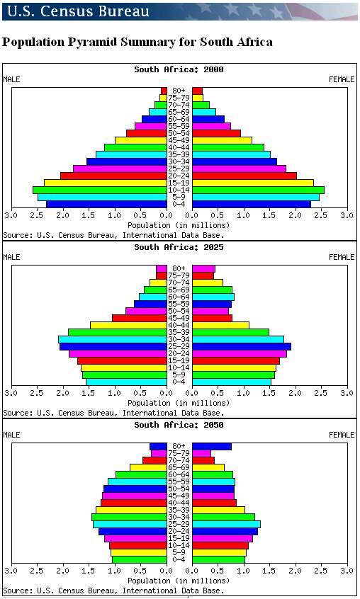
Population Pyramids for South Africa from 2000, 2025, and 2050
What do think is causing this weird shape in South Africa?
AIDS

Slide 6
Fertility Rate
Another indicator of population is the total fertility rate (TFR)— average number of children born to each woman over the course of her life.
Fertility rates tend to be higher
in less economically developed
Countries (LEDC) and lower in more
economically developed countries (MEDC).

Slide 7
Fertility Rate
A total fertility rate of 2.1 is known as replacement fertility; parents produce 2 children who will replace the parents when they die.
Zero population growth is when the birth rate equals death rate.

Slide 8
Economics
The world can be divided into two segments based on economic development.
More economically developed countries (MEDC) typically have per capita income exceeding $10,000.
Europe, Canada, the U.S., Japan, Australia, New Zealand.
Combined population of 1.2 billion.
Relatively stable populations.
Expected to grow 3% by 2050.

Slide 9
Economics
Less economically developed countries typically have a per capita income less than $5,000.
All other remaining countries of the world.
Combined population of 5.3 billion.
Nearly 3 billion live on less than $2 per day.
High population growth rates.
Expected to grow 52% by 2050 (8 billion people, or 86% of the world’s population).

Slide 10
Human Population Characteristics and Implications
Population growth and economic development

Slide 11
Economics
Human population growth is tied to economic development and is a contributing factor to nearly all environmental problems.
The degree of technological development and affluence is also significant; people in highly developed countries
consume huge amounts of
resources.

Slide 12
Economics
Economic Factors:
In less developed countries, the economic benefits of children are extremely important.
Even young children can be given jobs that contribute to the family economy, such as protecting livestock, gathering firewood, or carrying water.
Are often not sent to school because school systems are not government run.
They contribute to the family income
In the developed world, large numbers of children are an economic drain.
They are prevented from working.
They must be sent to school at great expense.
They consume large amounts of the family income.

Slide 13
Social Factors
Social Factors
Reducing fertility rates would be advantageous.,
Several factors (religious, traditional, social, and economic) influence the number of children a couple would like to have.
The major social factors determining family size are the status and desires of WOMEN in the culture.
In male-dominated cultures, traditional role of women is to marry and raise children.

Slide 14
Social Factors
Major Reasons for High Fertility Rates
1. Early marriages foster high fertility rates.
In Africa, 17% of births are to women in the 15-19 year-old range.
Total Fertility Rate of 5.1%

Slide 15
Social Factors
Major Reasons for High Fertility Rates
2. Lack of education opportunities for women reduces their options.
When level of education increases, fertility rates fall.
Financial independence leads to marriage later in life.
Better-educated women are more likely to have access to and use birth control.

Slide 16
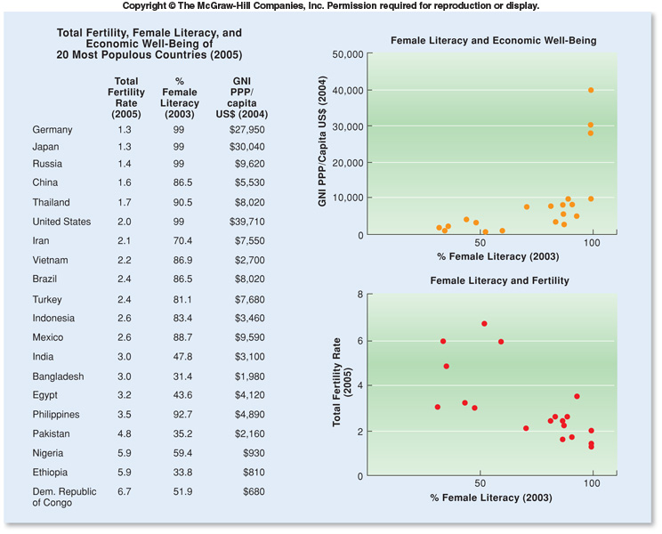

Slide 17
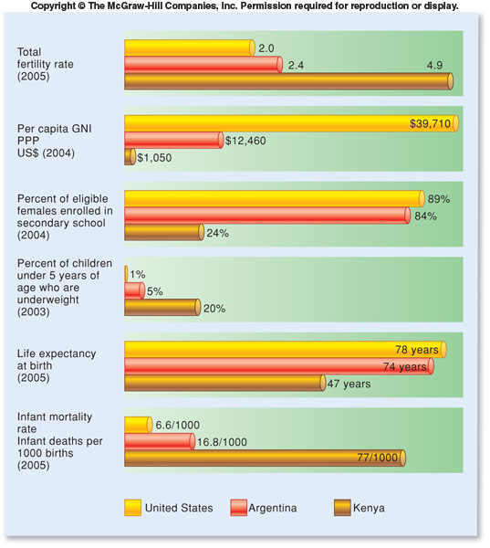

Slide 18
Political Factors
Political Factors
Governments can either reward or punish high fertility rates.
Several European countries are concerned about low birth rates and have instituted policies to encourage couples to have more children.
Paid maternity leave and guaranteed job availability upon the mother’s return to work.
Childcare facilities make it possible for both parents to work.
Child tax deductions provide an indirect payment to families.

Slide 19
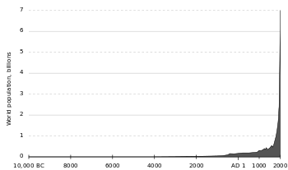
Political Factors
Most developing countries are concerned that population growth is too rapid and have instituted programs to limit growth:
They provide information on family planning and maternal and child health.
Sometimes governments provide free or low-cost contraceptives.
One-child policy in China (which just ended December 2015)

Slide 20
The U. S. Population Picture
United States population had a post-war baby boom period, significantly affecting population trends.
1947 – 1961: birthrates were much higher than today.
This created a population bulge.
As members of this group have raised families, they have had a significant influence on U.S. population growth and trends.
Legal and illegal immigration significantly influence future population growth trends.

Slide 21
The U. S. Population Picture
Changing age distribution of U.S. population

Slide 22
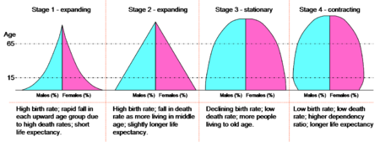
Comparison of LEDC to MEDC—identify which pyramids are LEDC and which are MEDC
Less economically developed countries (LEDC)
Less economically developed countries (LEDC)
More economically developed countries (MEDC)
More economically developed countries
(MEDC)

Slide 23
Hunger, Food Production and Environmental Degradation
People in less-developed countries generally feed at lower trophic levels than those in the developed world.
People in less-developed countries must eat plants themselves instead of feeding the plants to animals and eating the animals.
A lack of protein in the diet can lead to malnutrition.

Slide 24
Hunger, Food Production and Environmental Degradation
Many people in more-developed countries suffer from overnutrition.
50% of North Americans are overweight, and 25% are obese.

Slide 25
Hunger, Food Production and Environmental Degradation
Population and trophic levels

Slide 26
What Does the Future Hold?
We must remember that interactions with other species and with other humans will help determine our carrying capacity.
Four basic factors are involved in this consideration:
Available raw materials
Available energy
Waste disposal
Interactions with other organisms

Slide 27
What Does the Future Hold?
More people put more stress on the environment.
If the world continues to grow at its current rate, population will surpass 12 billion by 2060.
The human population is subject to same biological constraints as other species.
The human population will ultimately reach a carrying capacity and stabilize.
Disagreement about exact size and primary limiting factors due to technological advances as discussed earlier.

Slide 28
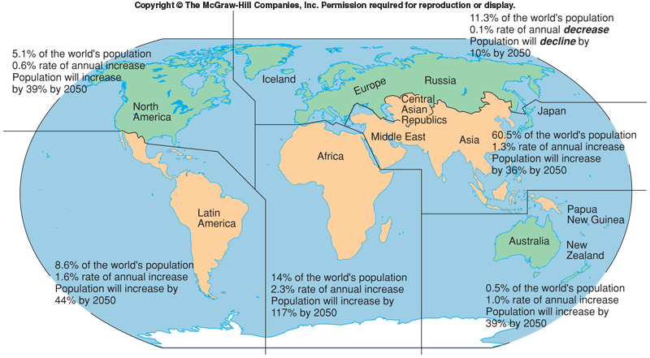
World Population Growth

Slide 29
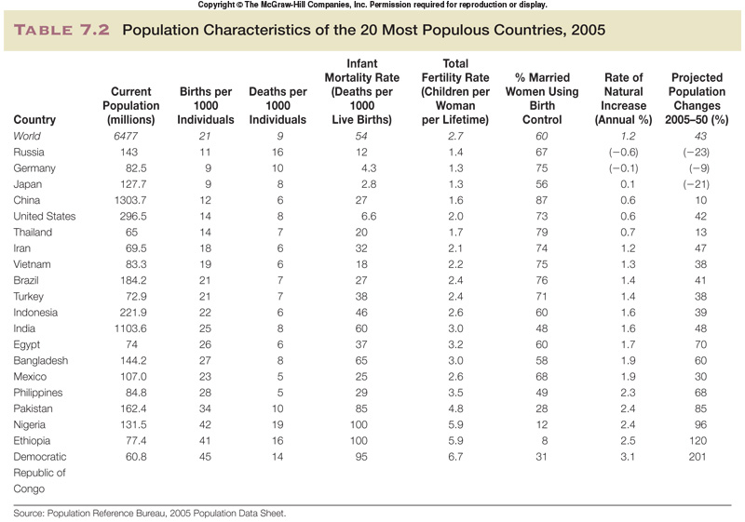

Slide 30
North America Population Comparisons

