Slide 1
Modelling is a scientific activity, the aim of which is to make a particular part or feature of the world easier to understand, define, quantify, visualize, or simulate by referencing it to existing and usually commonly accepted knowledge.

Slide 2
Oreo Membrane Models: In your lab book
Sketch and describe how the Oreo can be a model of the Gorter and Grendel model of the cell membrane. Include the following words in your description:
Cookie
Filling
Hydrophilic
Hydrophobic
Head
Tail
Phosphate
Glycerol
Fatty acid
Bilayer
STAMP!

Slide 3
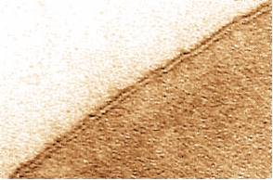
Oreo Membrane Models: In Your Lab Book
Cover the top and bottom cookie part of the Oreo with a layer of fruit roll up.
2. Sketch and describe how the oreo can be a model of the Davson and Danielli model of the cell membrane.
STAMP!

Slide 4
Oreo Membrane Models: In Your Lab Book
3. Remove the fruit roll up and then use a Jelly Bean to add an integral protein to your Oreo membrane model. Draw a third sketch of your model and label:
Hydrophilic
Hydrophobic
Phospholipid heads
Phospholipid tails
Integral protein

Slide 5
Oreo Membrane Models: In Your Lab Book
4. Use icing as glue to add TWO peripheral proteins (Jelly beans) to your membrane model. Add and label the peripheral proteins on to your third drawing.

Slide 6
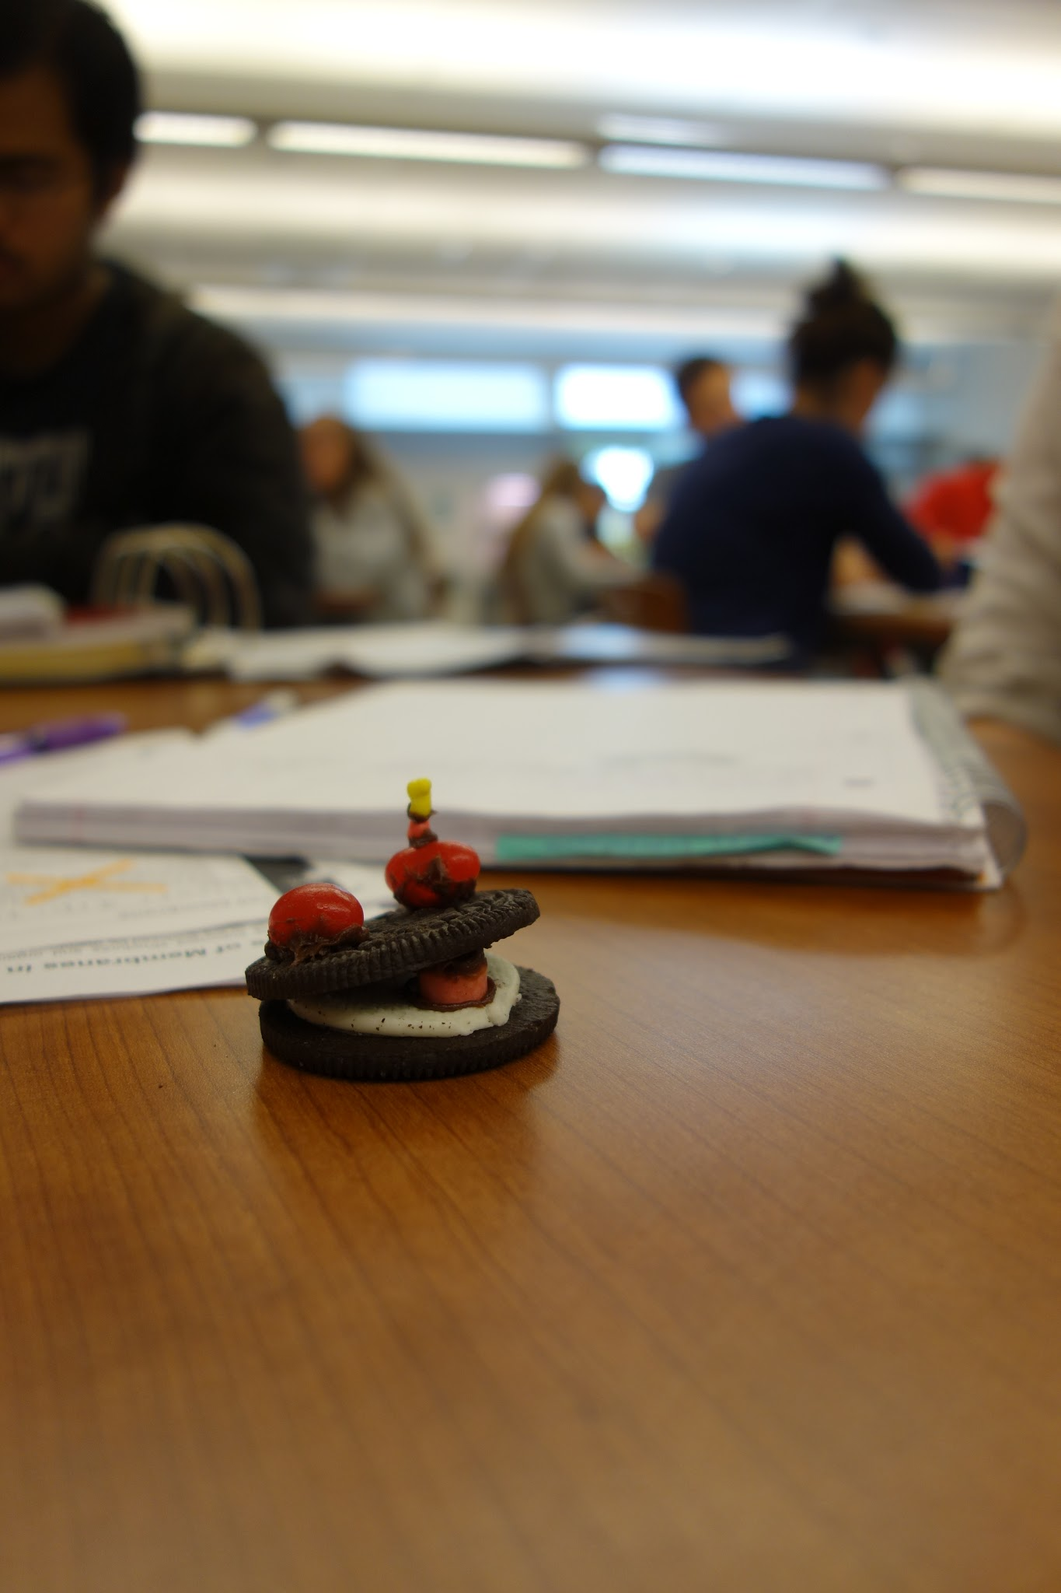
Oreo Membrane Models: In Your Lab Book
5. Use icing as glue to add a Nerd candy to ONE of the peripheral proteins.
What do you think the Nerd candy is modeling?
Add and label this structure on your third drawing.
STAMP!

Slide 7
Oreo Membrane Models: In Your Lab Book
6. Where are membrane bound proteins made in the cell?
7. How do membrane proteins get to the cell membrane from where they are made?
8. Where are the sugars (“glyco”) added to the proteins in the cell?

Slide 8
Oreo Membrane Models: In Your Lab Book
Whose model of cell membrane structure have we now modeled?
10. What is a scientific model?
11. Scientific models have limitations. In what 5 ways is your model different than an actual cell membrane?
STAMP!

Slide 9
Oreo Membrane Models: In Your Lab Book
Now EAT!

