Slide 1
Controls passage of materials into and out of the cell
All cells have it

Slide 2
Some bacteria have one or more
Used for moving cell around.

Slide 3
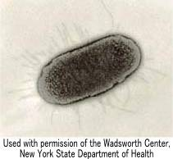

Slide 4
Float freely in the cytoplasm of all cells
The site of protein synthesis.

Slide 5
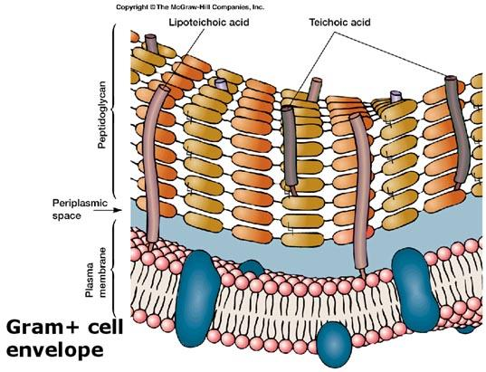
Gives shape, support and protection to the plasma membrane and cytoplasm of the cell.
made of peptidoglycan (protein-sugar molecules).
Notes:
‹#›

Slide 6
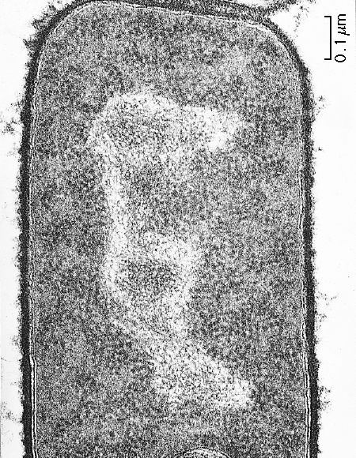
The glob of DNA in all prokaryotic cells
Still a double helix
Ends come together for form a circle
Not wrapped around proteins as in eukaryotic cells (termed “naked DNA”).
Notes:
‹#›

Slide 7
Fluid portion of all cells
Location of cellular metabolism

Slide 8
A special mucus-like protective coating found on some disease-producing bacteria.

Slide 9
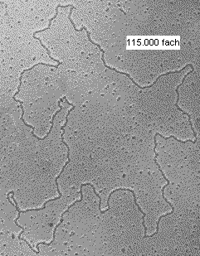
A small circle of DNA found in some prokaryotes that exists and replicates independently of the main DNA in the nucleoid.

Slide 10
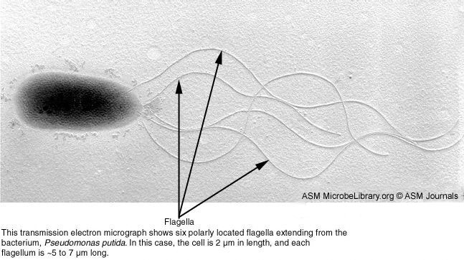

Slide 11
Short fibers projecting from the cell wall found on some bacteria.
They may help the bacteria cling to surfaces.

Slide 12
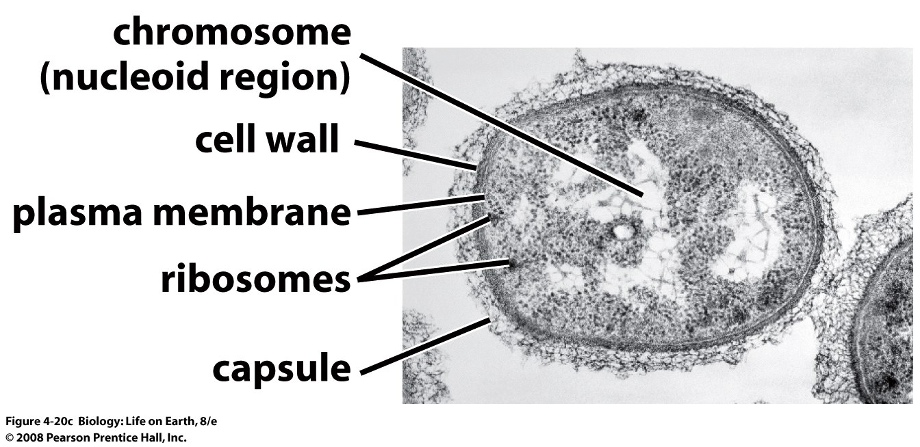
Identify the structures in this micrograph image.
KNOW
WHAT
THIS
IS...
A
B
C
D
E

Slide 13
Identify the structures in this micrograph image.

