Slide 1
Uncertainty in measurement

Slide 2
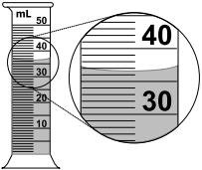
Read the volume below:
You likely said 36.5 mL (or 36.4 mL or 36.6 mL).
You are already familiar with the idea that to make a good measurement you estimate one decimal place past the smallest marking on the tool.

Slide 3
What if you didn’t have the tool?
If you just had a number in front of you (35.5 mL), you could tell certain things about the tool.
It measured volume.
It had the capacity to hold more than 35.5 mL.
The markings were every 1 mL (because you were able to estimate to the 0.1 place).

Slide 4
The “Uncertainty” makes that more explicit.
The uncertainty of a measurement tool tells you something directly about how close the markings are.
The uncertainty is half the distance between the smallest markings.
Uncertainty is reported after the measurement, with a + sign.
For example:
35.5 mL + 0.5 mL is a higher quality way of reporting the volume in the previous picture.
35.5 mL tells the volume including an estimated digit, and + 0.5 mL tells you the tool was marked every 1 mL, so your estimate could have been off by as much as 0.5 mL in either direction (hence the +).

Slide 5
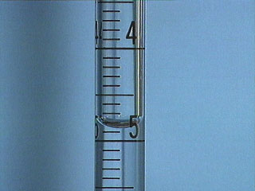
“Uncertainty” is half the distance between the closest markings on the tool. Examples:
The smallest marking is every _____? (1 mL)
So, half of that is ____? (0.5 mL)
Which means the complete measurement is ____? (35.5 mL + 0.5 mL)
The smallest marking is every _____? (0.1 mL)
So, half of that is ____? (0.05 mL)
Which means the complete measurement is ____? (4.85 mL + 0.05 mL)

Slide 6
Percent Error
When you want to compare your answer to the “right” answer, or compare your measurement to a better measurement, one strategy is to calculate the Percent Error.
The Percent Error is how much difference there is between your measurement and the better measurement (or “right” answer).
The equation is:
% Error = (Experimental – Theoretical) x 100
Theoretical

Slide 7
Definitions
Experimental is what you got in real life (i.e. the measurement you just made).
Theoretical is what you hoped to get (the “right” answer, or the measurement made with the better tool).

Slide 8
Example #1
Think of it as a quiz → the quiz is worth 10 points, you get 9 of those.
In a perfect world you would have gotten 10 (that is your theoretical number). You really got 9 (your experimental number).
So:
% Error = (Experimental – Theoretical) x 100
Theoretical
% Error = (9 – 10) x 100 = -10%
10
That means you got 10% too low (less than hoped for); that’s the meaning of the negative sign.

Slide 9
Example #2
Susie measures the length of her desk with a meter stick marked in decimeters. Her desk measures 0.65 m. (the experimental number)
Then Susie uses a meter stick marked to the millimeter. Her desk now measures 0.6435 m. (the better measurement – theoretical)
% Error = (Experimental – Theoretical) x 100
Theoretical
% Error = (0.65 m – 0.6435 m) x 100 = 1.01% error
0.6435 m
Notice that error can be positive (your measurement was bigger than it should have been)!

